Slide 1
Supporting Our Doctors
and
Peer to Peer Support
Dr Alison Wright FRCOG
Vice President, UK & Global Membership

Slide 2

Working in Obstetrics and Gynaecology
of Good Complaint Handling
Positives !
A stimulating and rewarding career
Privileged to share in joyous, life-changing events in people’s lives
Focused on improving women’s health at all stages of their lives
Versatile specialty – combining medicine and surgery
Opportunities for personal career development, varied career paths
Close working with other specialties

Slide 3

Working in Obstetrics and Gynaecology
of Good Complaint Handling
The challenges:
Undermining and bullying behaviour long been recognised as a problem in O&G
Trainees report more undermining behaviour than any other medical specialty
64% of consultants experienced or witnessed consultants being bullied
A high risk specialty with disproportionate rates of litigation
Difficult to manage work/life balance
Independent practitioners working in multi-disciplinary teams

Slide 4
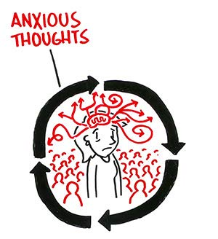
The Impact of O&G Challenges?
of Good Complaint Handling
High stress, burn-out and sickness
Defensive practice -
A blame and shame culture
Varying leadership and support
Poor team working
Variable clinical supervision and training opportunities
High rates of attrition from specialty training (average 30%)
Rota gaps
… all of which leads to:
Poor workplace cultures and more of the above

Slide 5
RCOG Vision
of Good Complaint Handling
Actively supporting our members, so that they can more effectively advocate for the women they look after
A culture where doctors feel actively supported to prevent, minimise and manage workplace stress, collaboratively and openly, for the benefit of their own and their patients’ wellbeing

Slide 6
Supporting Our Doctors Task Group
of Good Complaint Handling
A strategic intervention and approach:
Representatives from across the profession and health care
Calling for wide-scale, systemic change
Advocating to support that change
Developing and promoting support tools and services
Supporting Our Doctors Task Group
GMC
Other Royal Colleges
O&G Trainees
O&G Consultants
Medical Defence Organisation

Slide 7

Peer to Peer Support
of Good Complaint Handling
A panel of task group members
Guidance on workplace issues
A ‘connection’ service and way for members to support and guide each other
One-off support or may lead to an ongoing dialogue
Issues:
  Mainly non-clinical
  Interpersonal
  Return to work options
Strictly private and confidential; unless mentor and mentee agree otherwise or a safety issue arises

Slide 8
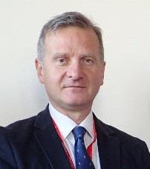
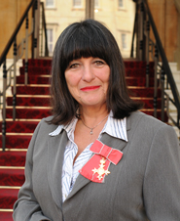
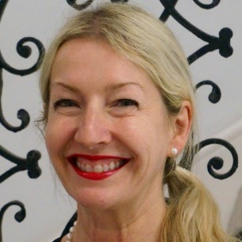
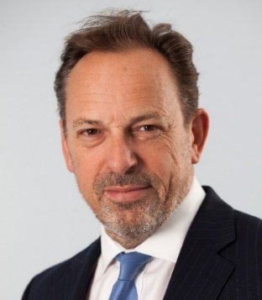
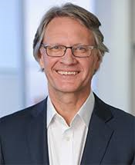
Expert Opinion Service
of Good Complaint Handling
Helps doctors and their employers to resolve complaints locally
Provide an objective ‘opinion’ on the options available to the employer i.e. restricted practice rather than suspension
Both doctor and employer must agree to use and participate in the service
Panel of task group members review situation from both sides
An opinion offered within 2 weeks

Slide 9
Workplace Behaviour Champions and Undermining Toolkit
of Good Complaint Handling
A Workplace Behaviour Champion in every school/deanery across the UK
A resource for trainees and SAS/Trust doctors who want independent advice to tackling unacceptable behaviour
The Undermining Toolkit (aimed at all career stages and roles):
  Case studies
  Online resources and tutorials
  Guidance for managers and organisations

Slide 10

A Principles Based Approach
of Good Complaint Handling
Governs behaviours and interactions with others e.g. honesty, fairness, integrity
Determines outcomes/consequences of our actions and behaviours
Easy to relate to, describe, advocate, implement and remember
RCOG are developing and advocating principles of:
  Good complaints handling
  Anti-bullying and undermining
  Leadership
  Wellbeing

Slide 11







Principles:
of Good Complaint Handling
INCLUSION
PEER SUPPORT
TIMELINESS
COMPETENCY
EQUALITY
Exclusion should be a last resort having demonstrated that no other realistic and acceptable work can be offered, e.g. limiting an area of practice or teaching
Doctors should be encouraged to support and speak to colleagues experiencing difficulties
Complaint handling and investigations must be completed in a timely manner
Training for everyone handling and investigating complaints
A nationally recognized and applied framework for complaint handling, to ensure parity and consistency across the profession

Slide 12
Questions?

