Slide 1
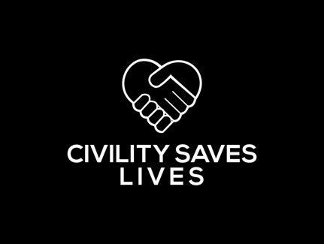
When we permit rudeness our patients die unnecessarily
@civilitysaves

Slide 3
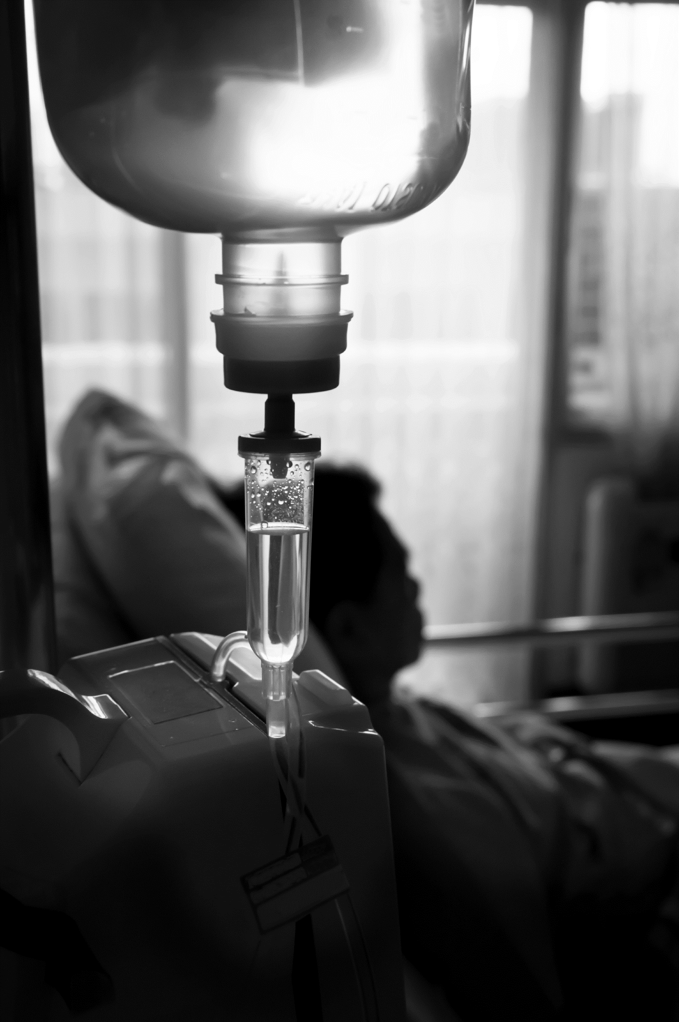
Notes:
Theatre was tense. List 2 became 3
Story- ordinary Tuesday, theatre, extra case. Protest but decide unfair on the patient. 1st case, consultant felt to be hostile, team stressed, crying scrub nurse (replaced). Consultant didn’t notice. Case finished, Scrub back for 3rd case. Registrar in theatre assisting. At end swab count done – correct. Multiple returns before large swab found in abdomen.
And we punished the scrub nurse. And we missed the point.
“just get on with it”
Chest drain, agony, denied morphine “must be a morphine seeker”

Slide 5
Teams
Notes:
So if healthcare is a team game and we work in complex environments…how do we make teams perform at their best

Slide 6
Notes:
Last few years science

Slide 7
Variation in outcomes for complicated/complex situations
Catastrophic outcome
Amazing outcome
Notes:
5 conditions >70%- real team, compelling direction, enabling structure, supportive context, and competent coaching
Support- why we work better as a team when we support each other in the fight- but this does not mean that the patient gets the best treatment

Slide 9
Incivility
Notes:
New science
1996-2000 (23) 2011-2015 (1700)
We talk about incivility as rudeness, or disrespect. The key is that it’s all in the eyes of the beholder
The elephant in the room. Both the cause of incidents and prevents us getting to the cause
Riskin and Erez
Shouting and learning- large emotional response, little intellectual one. Different pathways. One shoves the other out.
If you think healthcare staff need to be aroused you are hugely likely to be just plain wrong.

Slide 11
Have you seen rudeness at work?
Notes:
Maybe at you, near you, maybe it was you?
Mine was a consultant screaming at me about a transcription error. I was too stressed to even think….
Surgeon screaming at assistant

Slide 12
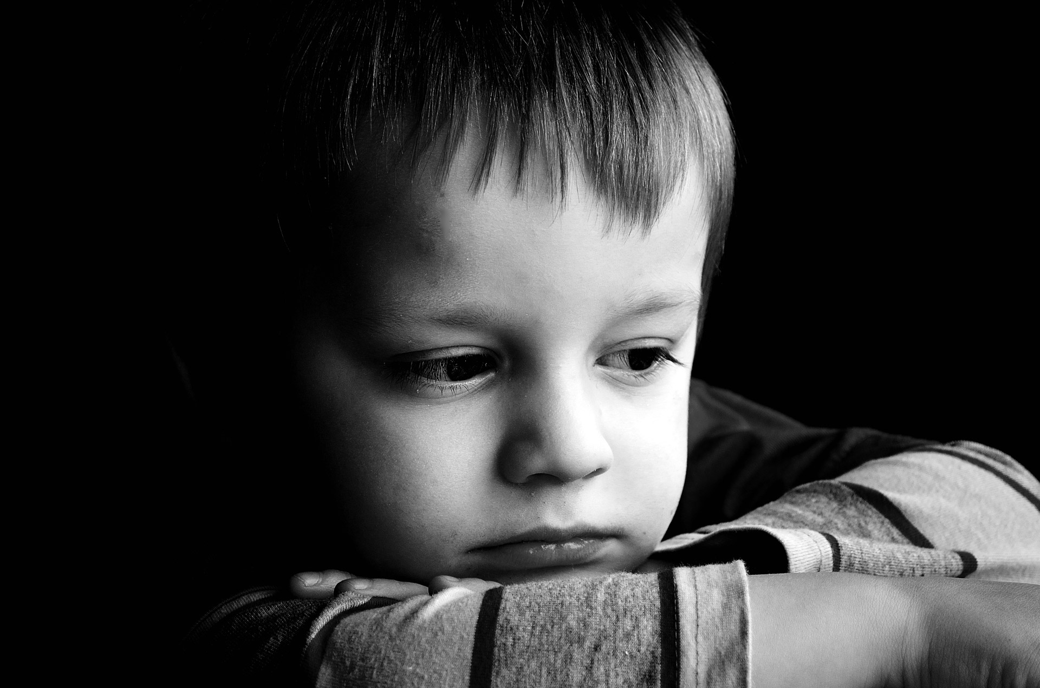
How did it feel?
Notes:
Anger, resentment, stressed, unable to think? Ashamed?
So incivility makes us sad. So what?

Slide 13
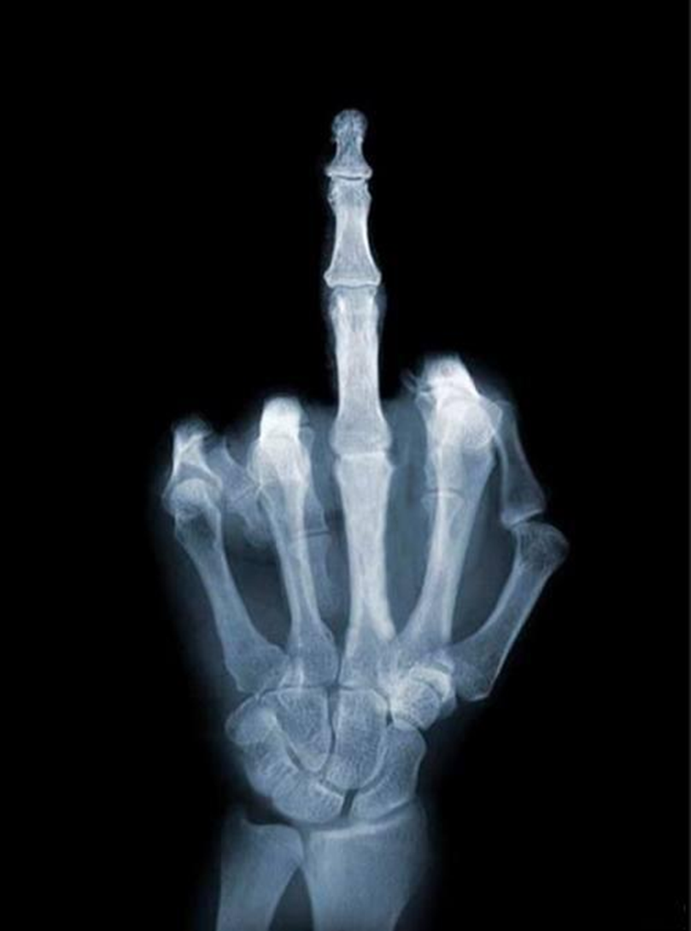
How did you respond to the rudeness?
Notes:
“maybe I’m just too sensitive”
Did anyone feel less motivated? Humiliated?
A kind of lonely feeling

Slide 15
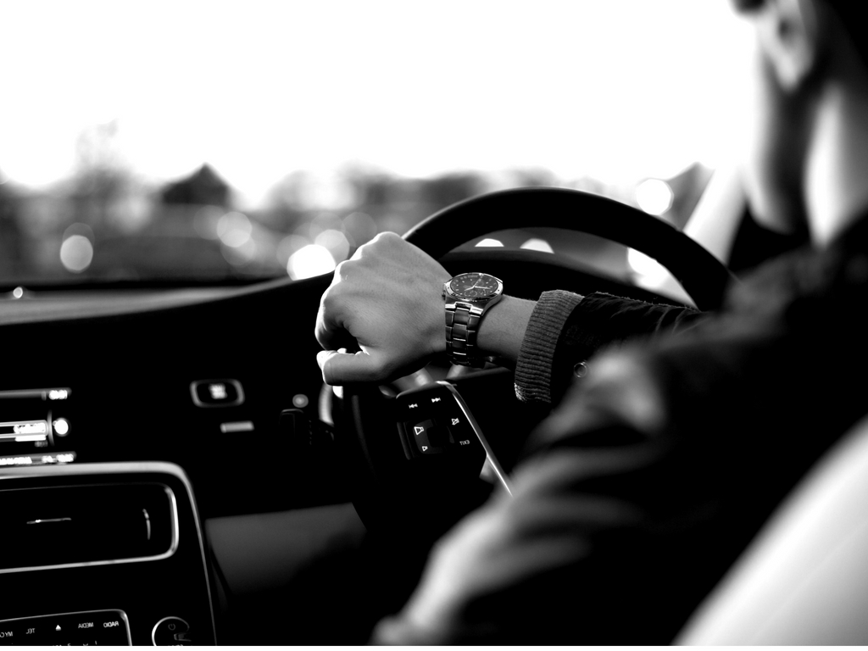
Impact on the recipient
61% reduction in cognitive ability
Notes:
Also, reduced hand-eye co-ordination (important for surgeons)
5x more likely to miss the gorilla. Nurses 50% more likely to miss a calculation error.
https://thepsychologist.bps.org.uk/volume-24/edition-7/how-rudeness-takes-its-toll

Slide 16
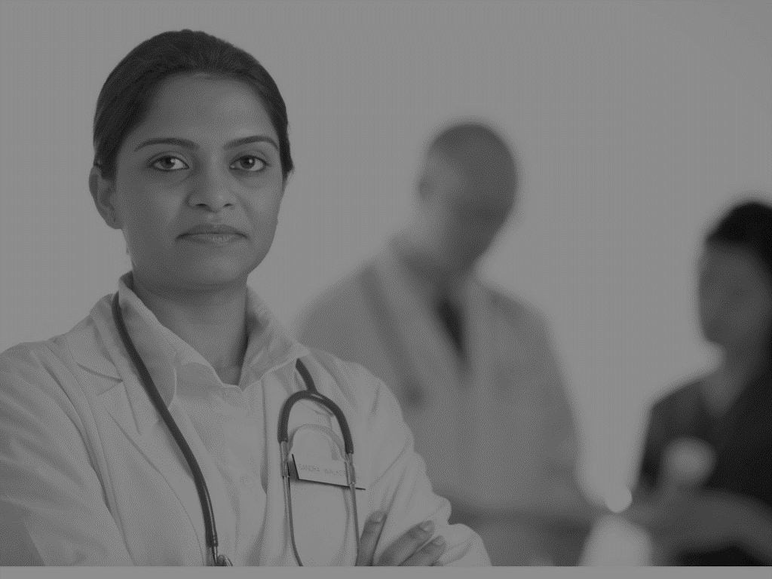
Impact on staff onlookers
20% decrease in performance.
50% reduction in willingness to help others.
Notes:
When all around you heads go down…they are not concentrating on the work- they are trying to avoid the emotion and hoping it does not swing to them…
Porath C, Erez A. Overlooked but not untouched. How rudeness reduces onlookers’ performance on routine and creative tasks. Organ Behav Hum Decis Process 2009;109:29-44.

Slide 18
Notes:
Power corrupts Stanford. Intoxicating. We change 3X ipad, interrupt, raise voice
Permission and impact. Biscuits. Seniority. We behave as though seniority is an excuse, not a responsibility.
Bosses, authority, you! Ripples. More impact and frequently worse behaviour
We get there through asking then we end up telling.
Biscuits/ zebra crossing experiments
If we raise the level of arousal in the room we need to know the impact that is having- we can’t just do it because we are the boss.
Zebra crossing/Farah.
Only 4% of people say they are rude because they can get away with it. Many don’t know they were rude.
https://hbr.org/2016/10/dont-let-power-corrupt-you

Slide 20
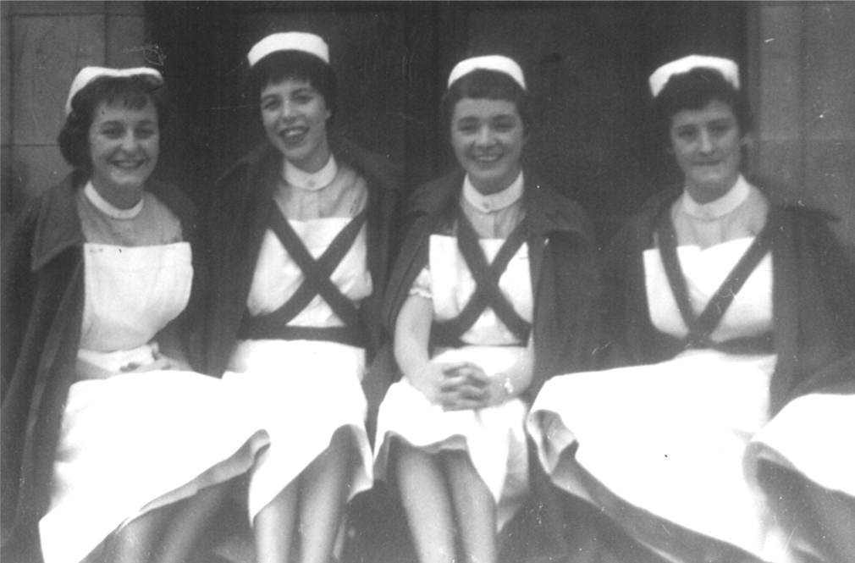
My mum
Notes:
At the Western General Hospital 1959
Wards, cigarettes advised

Slide 21
Notes:
Then we found out the impact and we changed what we said. In the last few years we have discovered the impact of incivility. And that’s great

Slide 22
what a wonderful opportunity….
Notes:
Because we have a brilliant opportunity to do more good for our patients whilst making the workplace better for the vast majority of us and to help our teams (and ourselves) perform at our very best.
I hope I’ve made my point- because if I have then we have a brilliant opportunity to do more good for our patients whilst making the workplace better for the vast majority of us

Slide 23
civility saves lives

