Slide 1
Life as an FY1
By Dr Rebecca Irwin
Notes:
I was given the title Life as an fY1
NI I went to Northern Ireland
Give you guys some insight in to the realitiy of a job
Name,
Finishing
The realities of the job

Slide 2
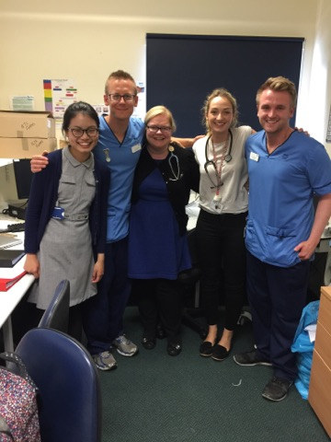
Notes:
Thrown in at the deep end
Front line. Speak about those first few days.
People now look to you. As a medical student
Confidence improves
Story that made me question …what I learnt
Story reason why

Slide 3
Notes:
Consultant ward round
Letter to Gos

Slide 4
Notes:
Histories and examinations
My first job in MAU – admitting medical patients

Slide 5
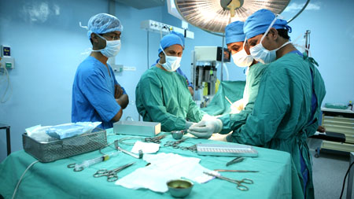
Notes:
Histories and examinations
My first job in MAU – admitting medical patients

Slide 6
Notes:
Histories and examinations
My first job in MAU – admitting medical patients

Slide 7
Notes:
Histories and examinations
My first job in MAU – admitting medical patients

Slide 8
Notes:
Histories and examinations
My first job in MAU – admitting medical patients

Slide 9
Notes:
Histories and examinations
My first job in MAU – admitting medical patients

Slide 11
Notes:
Type of stress
Sometimes want to quit
Ring up the ward
Making mistakes and crying

Slide 13
Attributes of good FY1
Team player
Confidence/Know your limitations
Organisation/Prioritisation skills
Communication
Problem solving ability
Enthusiastic

Slide 14
Notes:
There is always someone there to ask for help!

