Slide 1
It’s a big wide world out there
A personal reflection
One medical career – this is my story
James Campbell
Surgeon Captain RN (Retired)
Now semi-retired General Surgeon in the Highlands and Islands

Slide 2
Somewhere out there….
Medicine is a close community but a broad parish
Your personal combination of skills and enthusiasms will be unique
Nobody really knows the shape of medicine in the future
There is a niche out there just for you
All you have to do is look for it

Slide 4
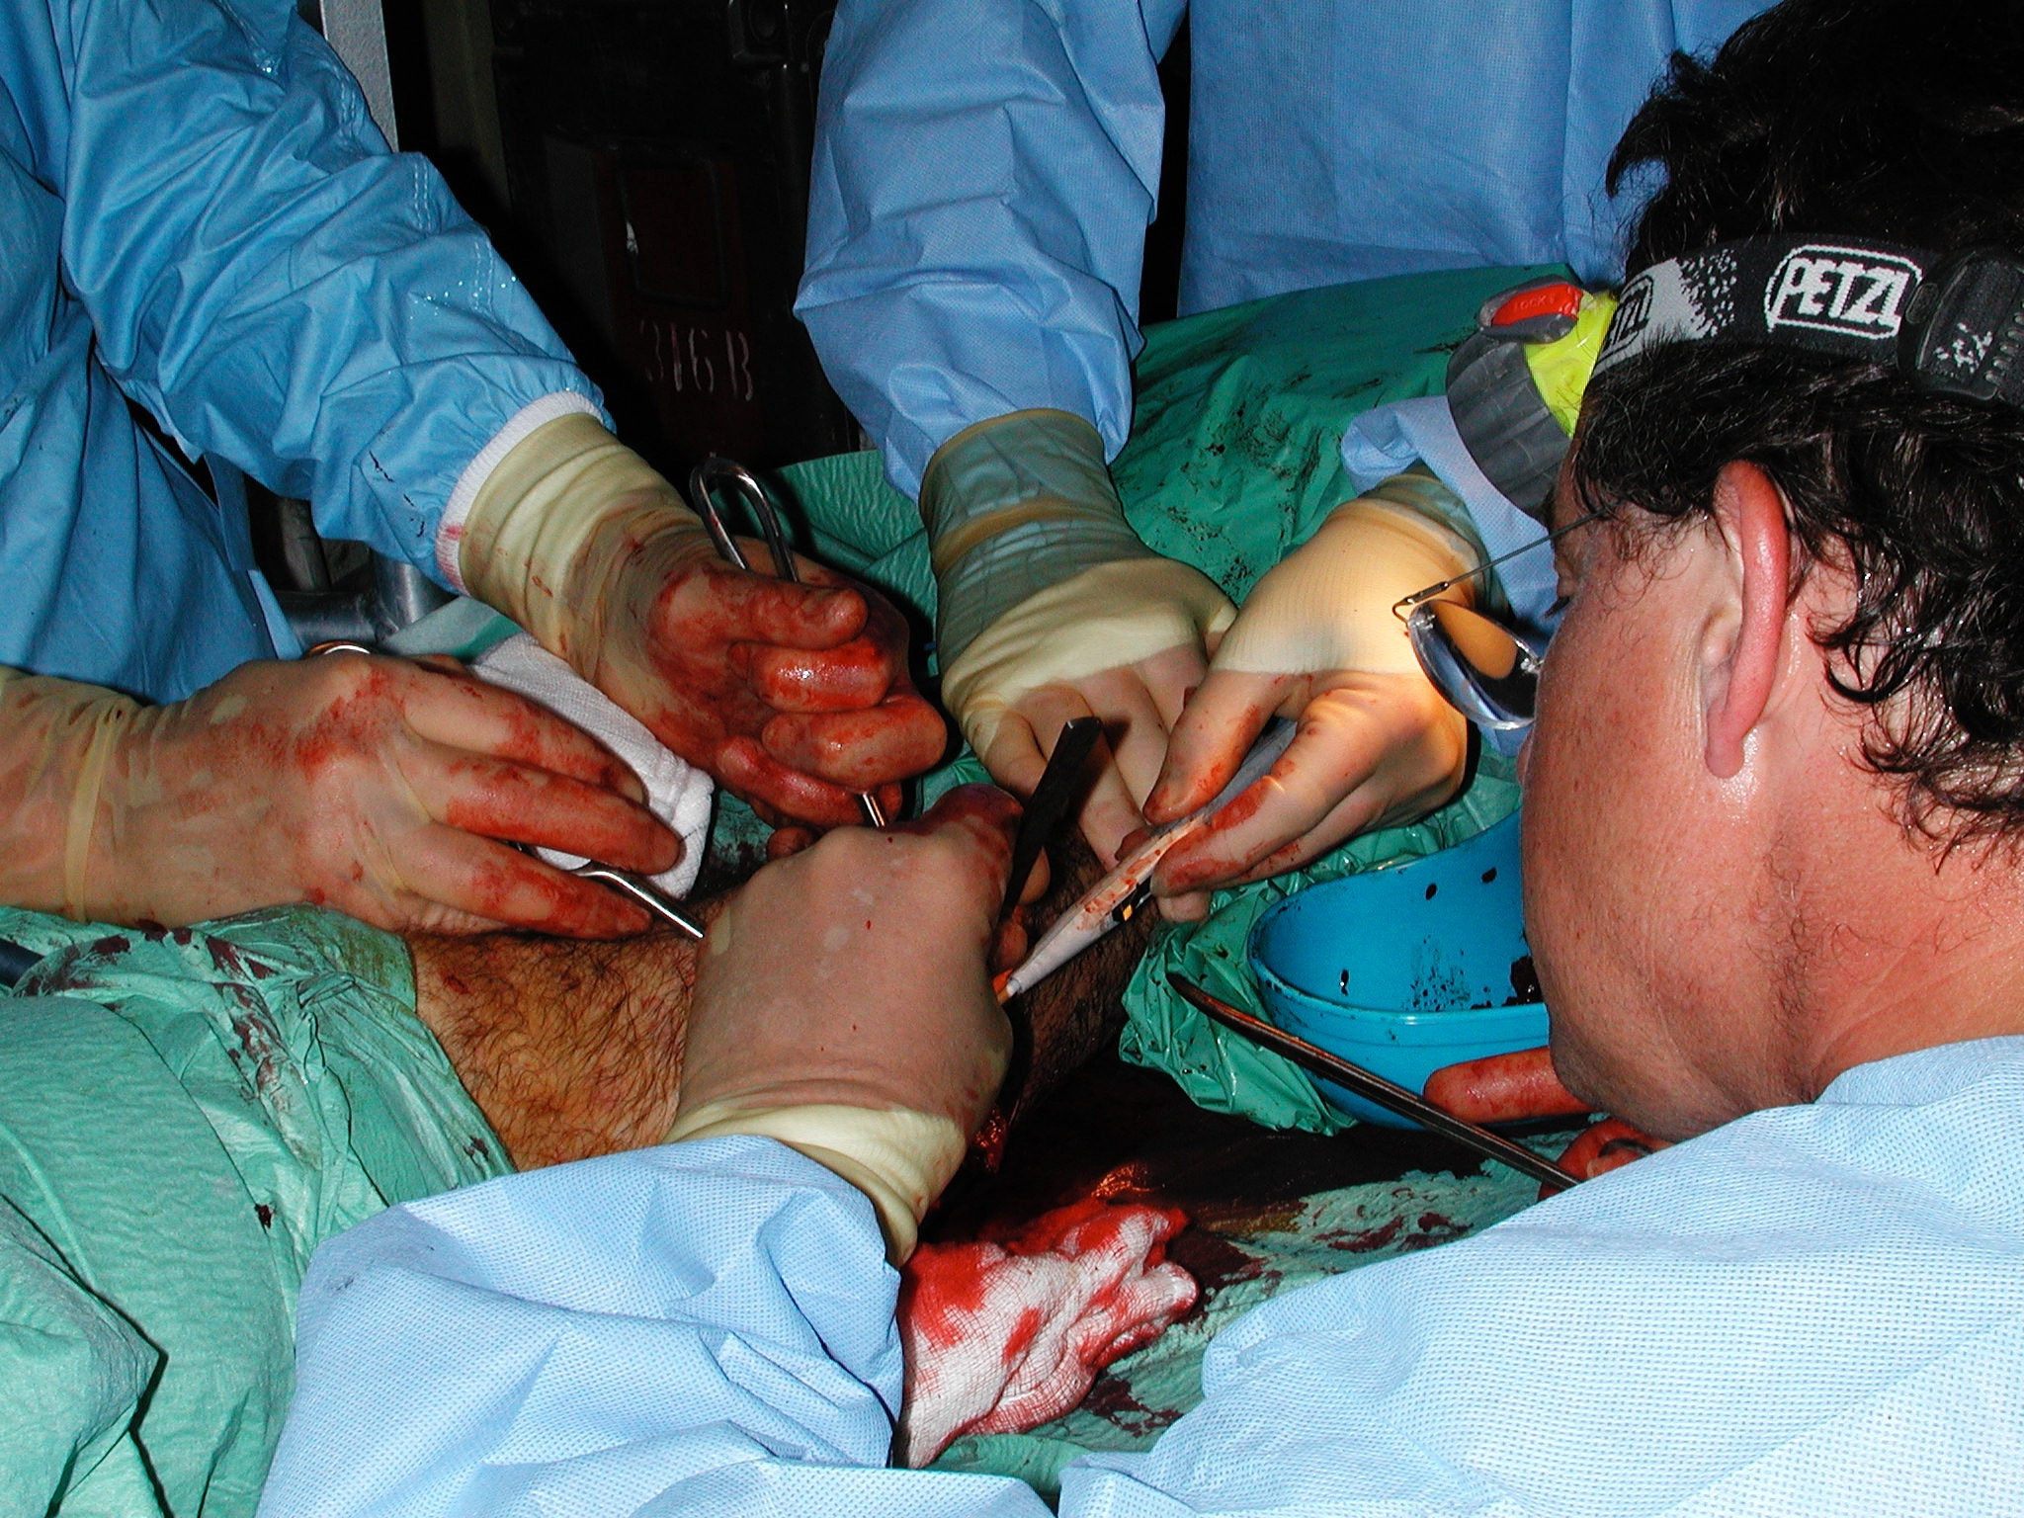

Slide 5
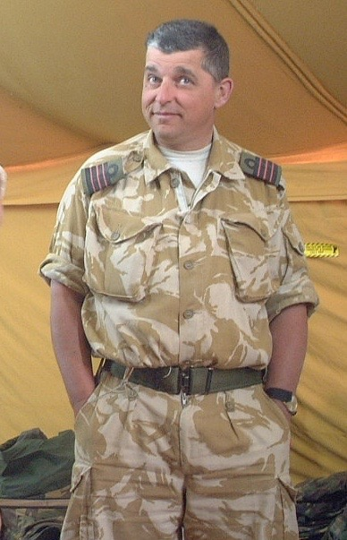
one short, fat scotsman’s journey
Failed university applicant
Got in by the skin of my teeth
Loved medical school, loved surgical specialist training, loved the military bit and all its challenges
Always seeking something different - there is more to life than medicine!
40 years on, too old, too slow and too fat for the Royal Marines but loving life in the remote hospitals of Scotland

Slide 6
The joys of Medical School
It’s all news
There is so much of it and it is really interesting
You never know when it is going to come in useful, what is going to ring your bells or fire your rockets
You meet inspirational people in all their rich diversity who will propel you on your way

Slide 7
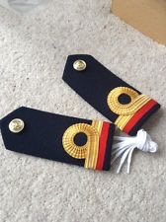
Taking the Queen’s Shilling
There is more to life than medicine!
Opportunity to live a life less ordinary
Financial independence!
Seemed like a good idea at the time

Slide 8
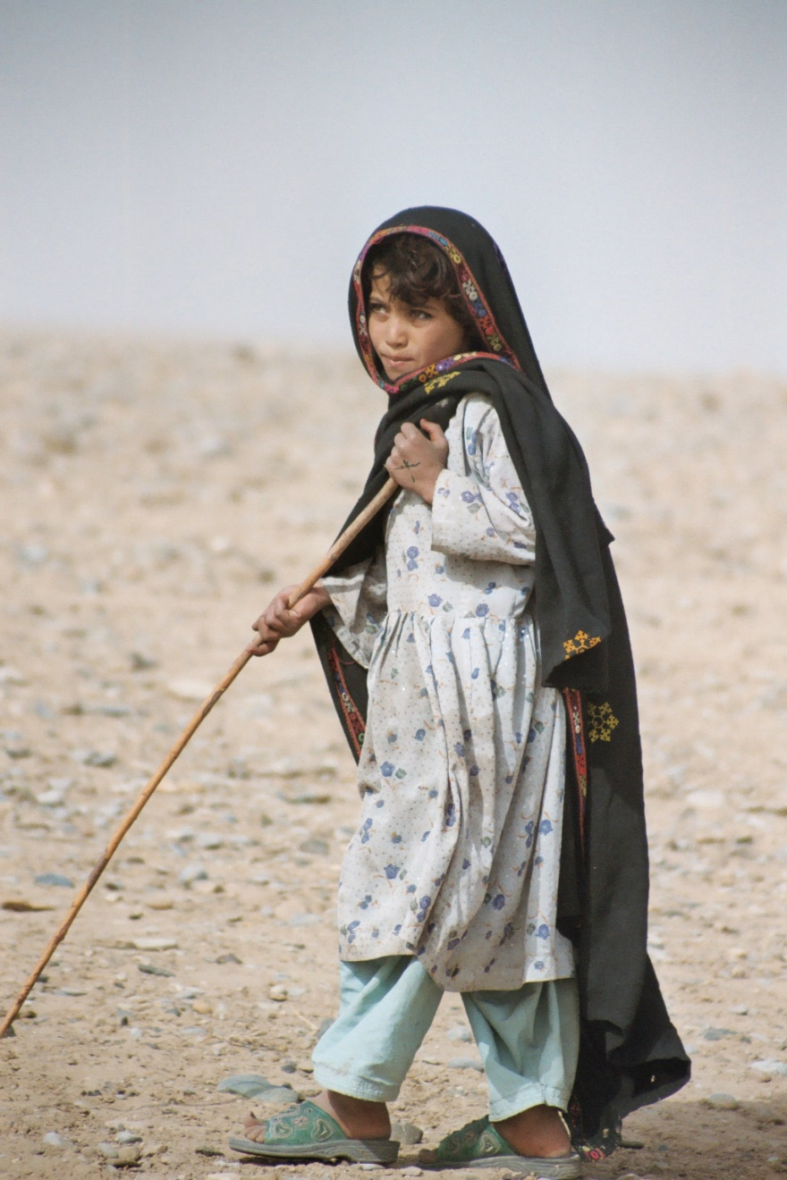
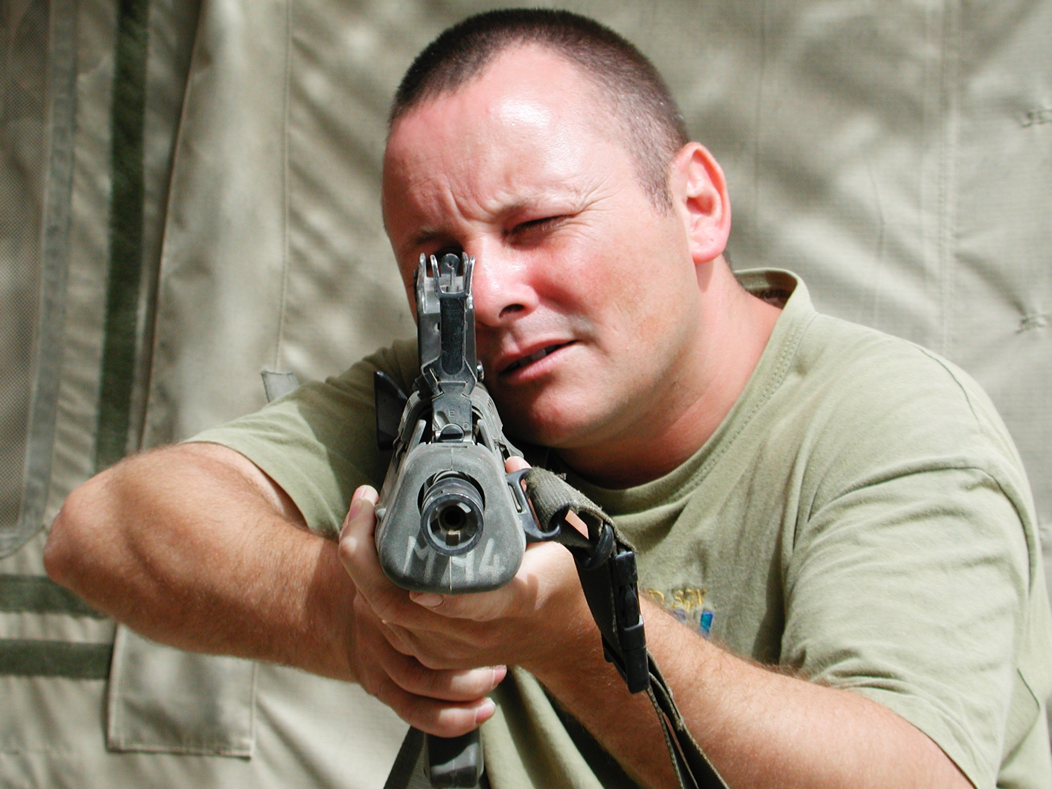
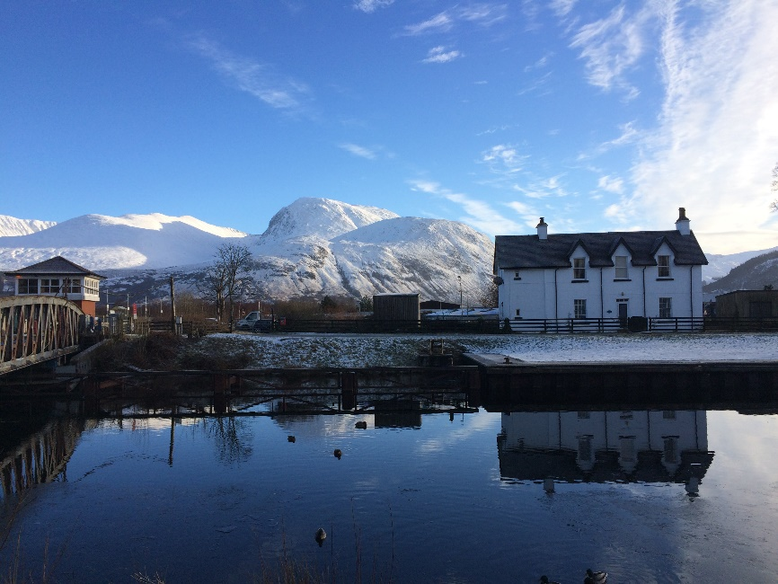
What larks
Opportunity to practice medicine and surgery in the broadest sense
Often using your own resourcefulness with limited physical resources
Get to go to some pretty funky places, and some less alluring
Occasionally, people shoot at you
Work with (and on) some fascinating people

Slide 9
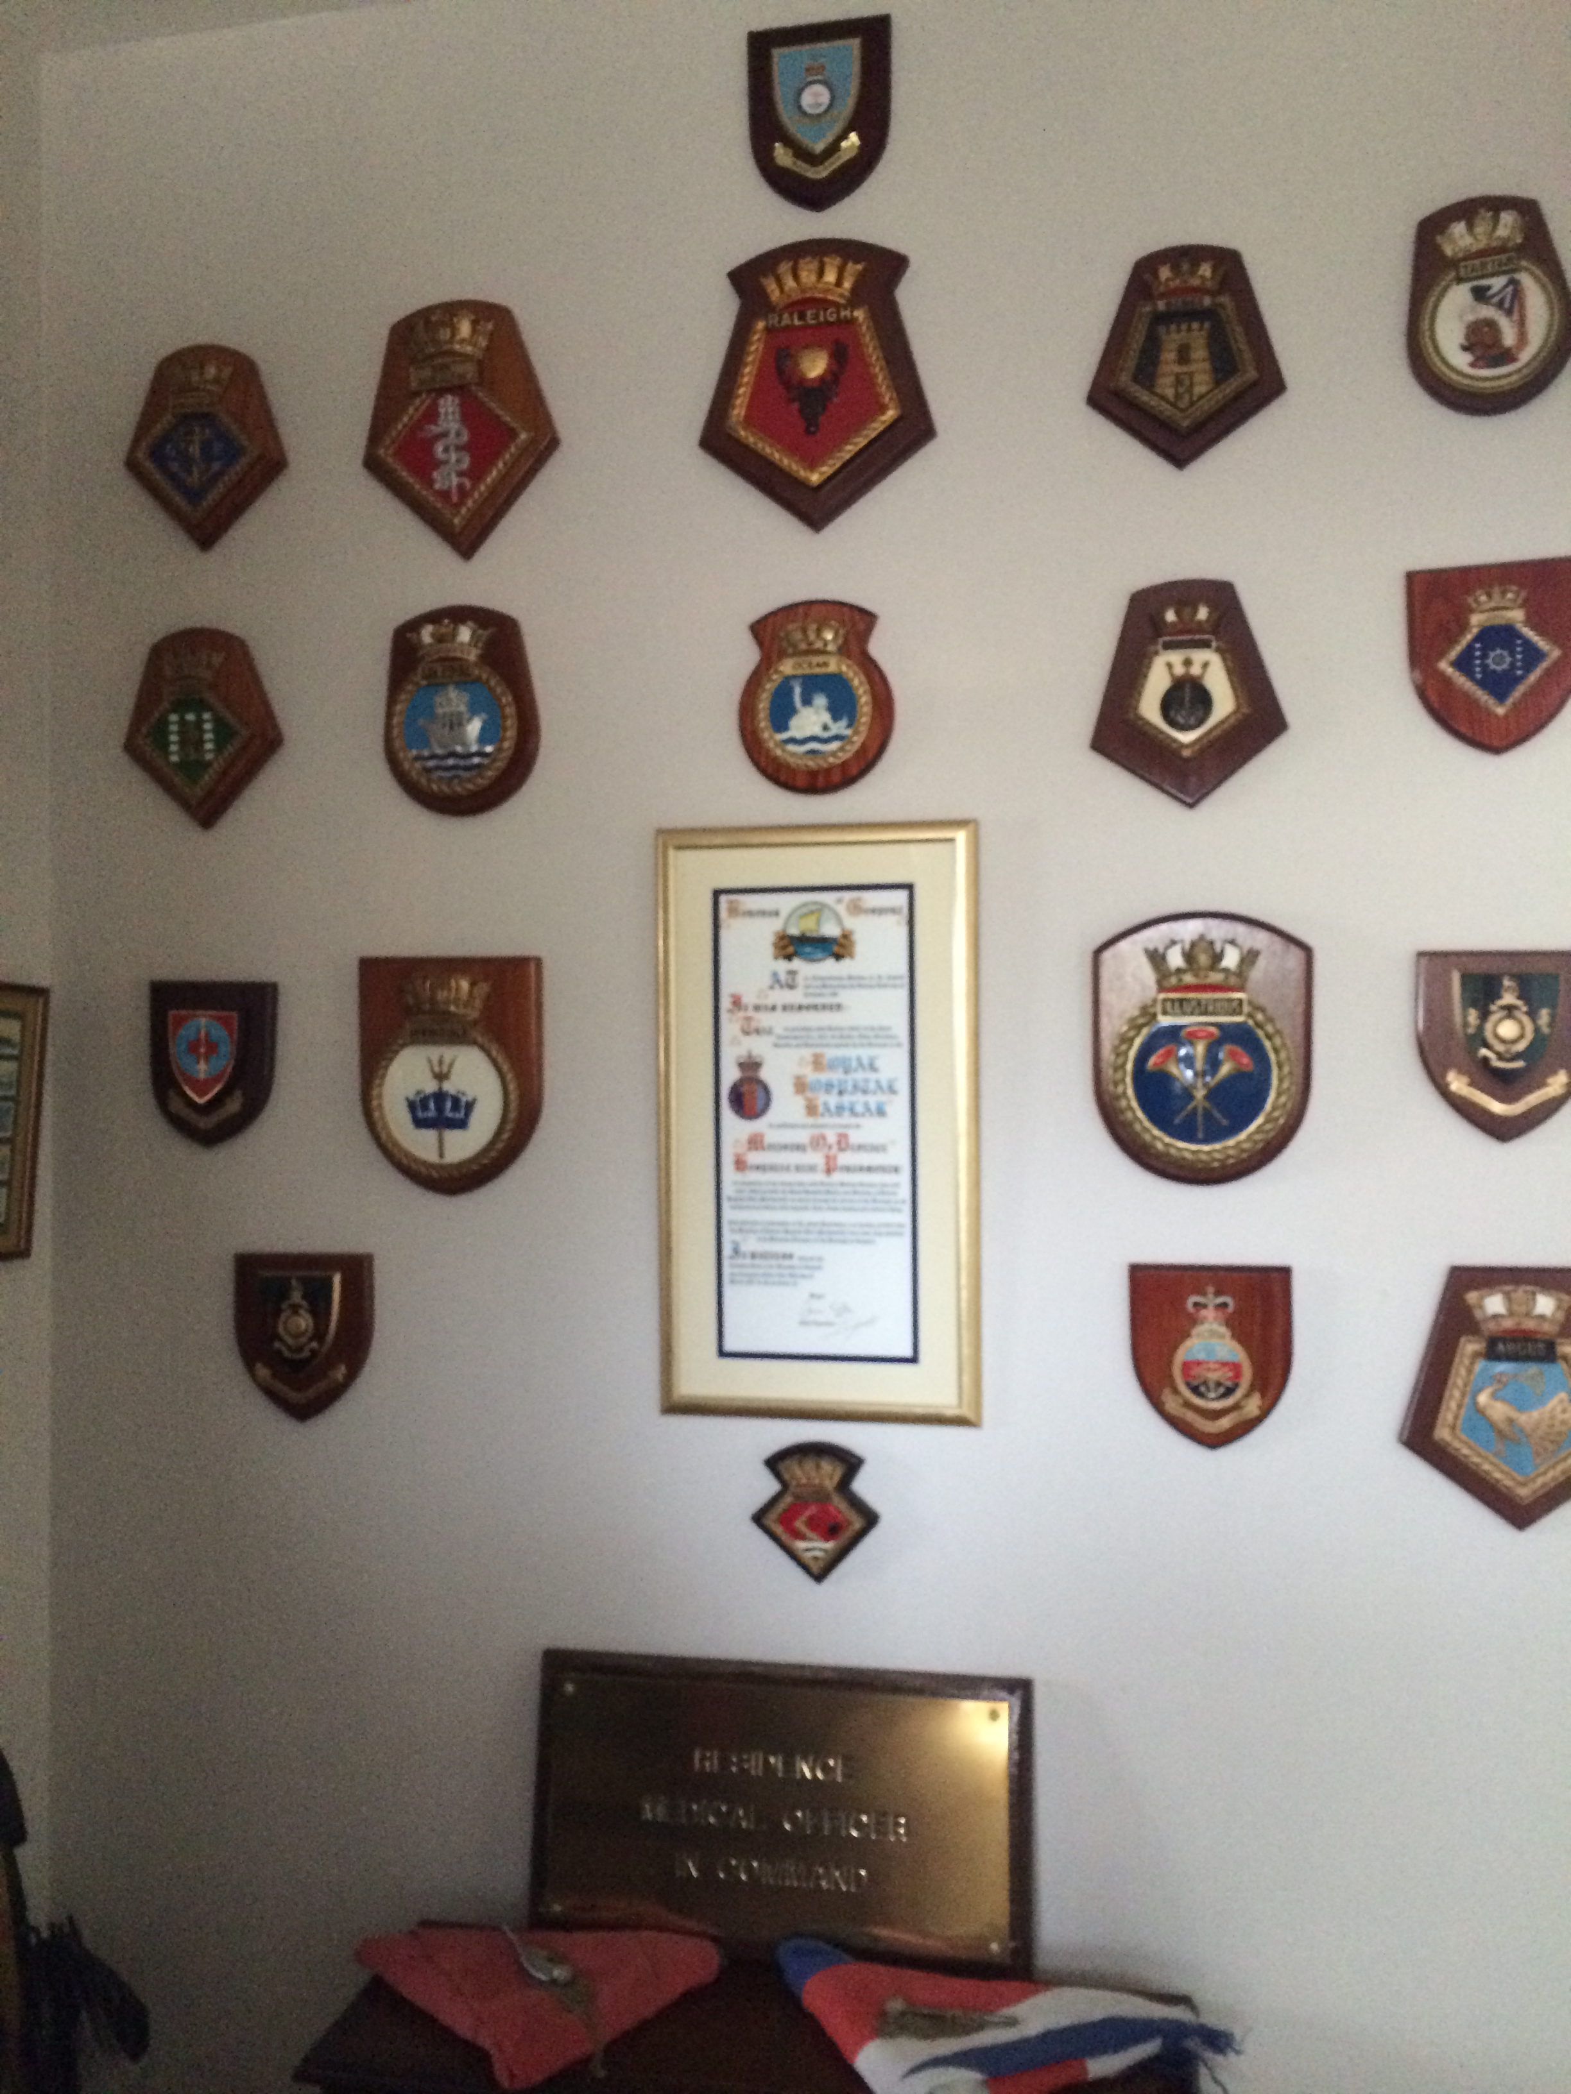
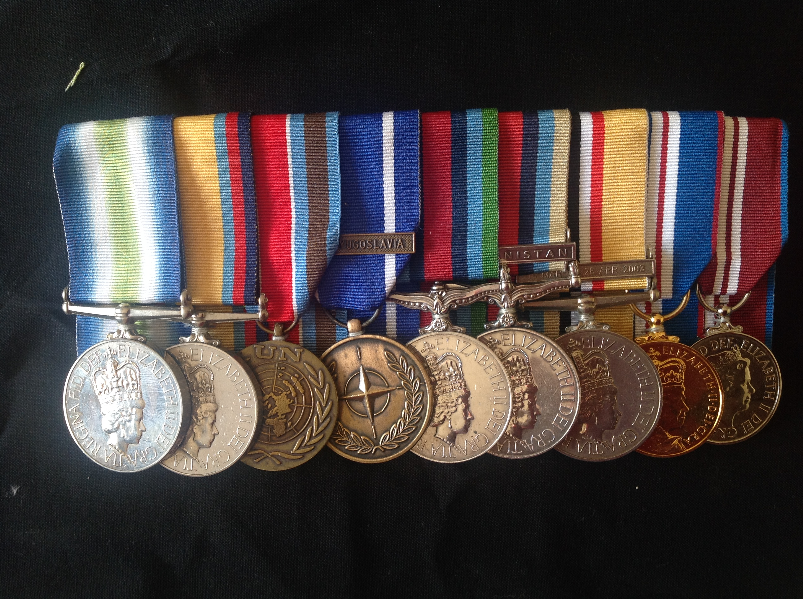
“What did you do in the war, daddy?”
Many deployments by land sea and air
Medicine and surgery in peace and war
All of the oceans and all of the continents
Regular training in my chosen specialty and sub-specialty
Fewer fully functioning joints than most of my contemporaries

Slide 10
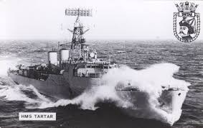
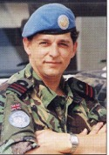
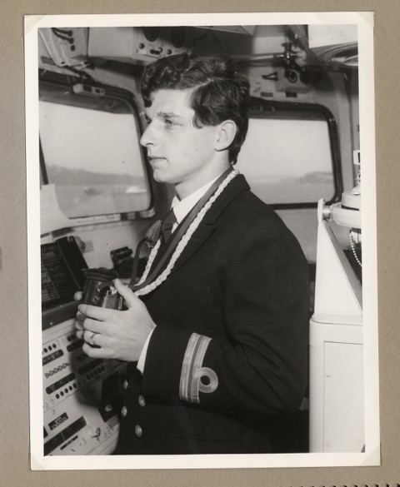
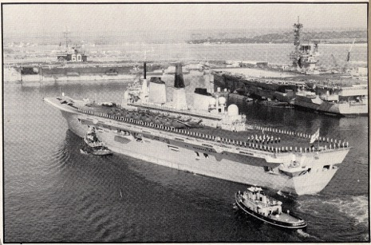
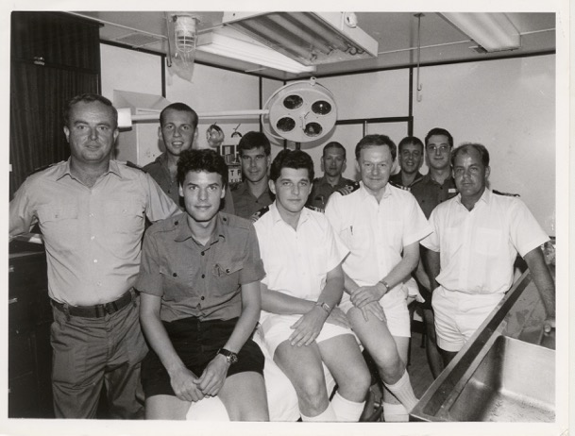
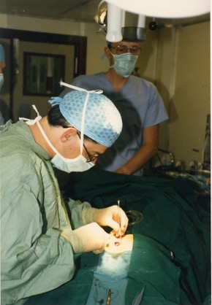
Wasn’t it all such fun

Slide 11
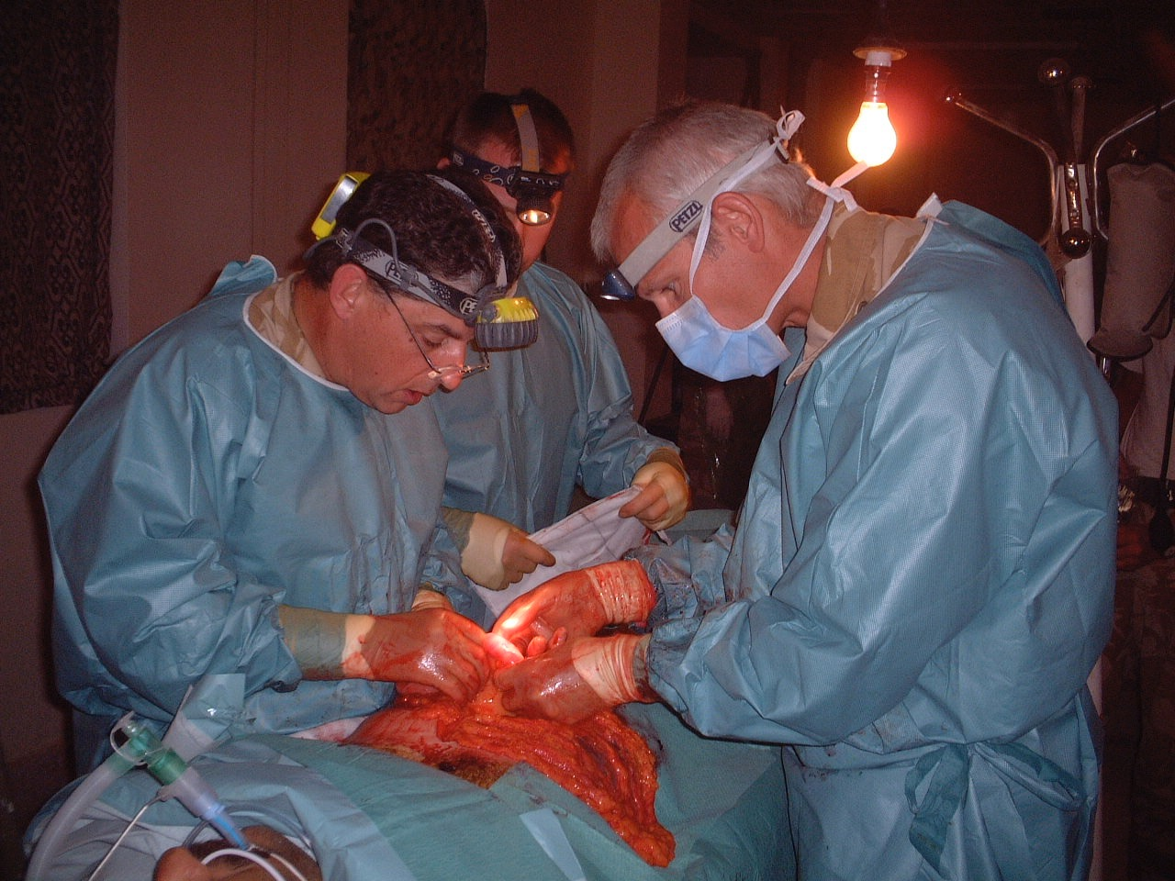

Slide 12
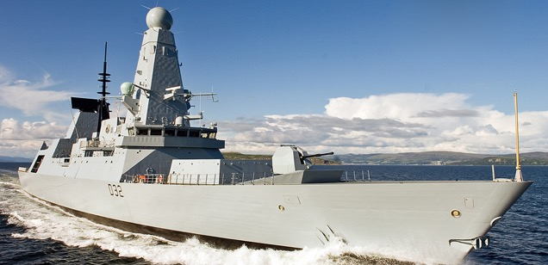
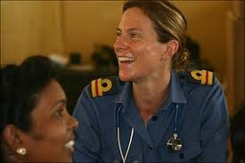
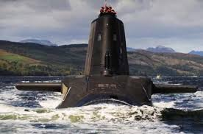
The Royal Navy
Si vis pacem, para bellum

Slide 13
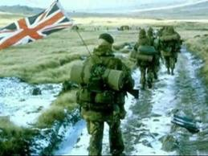
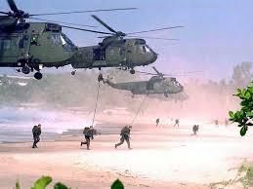
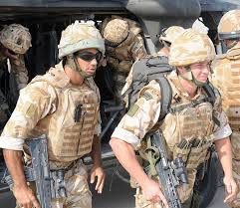
royal marines just dropping in
Per Mare, Per Terram

Slide 14
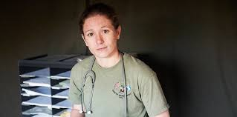
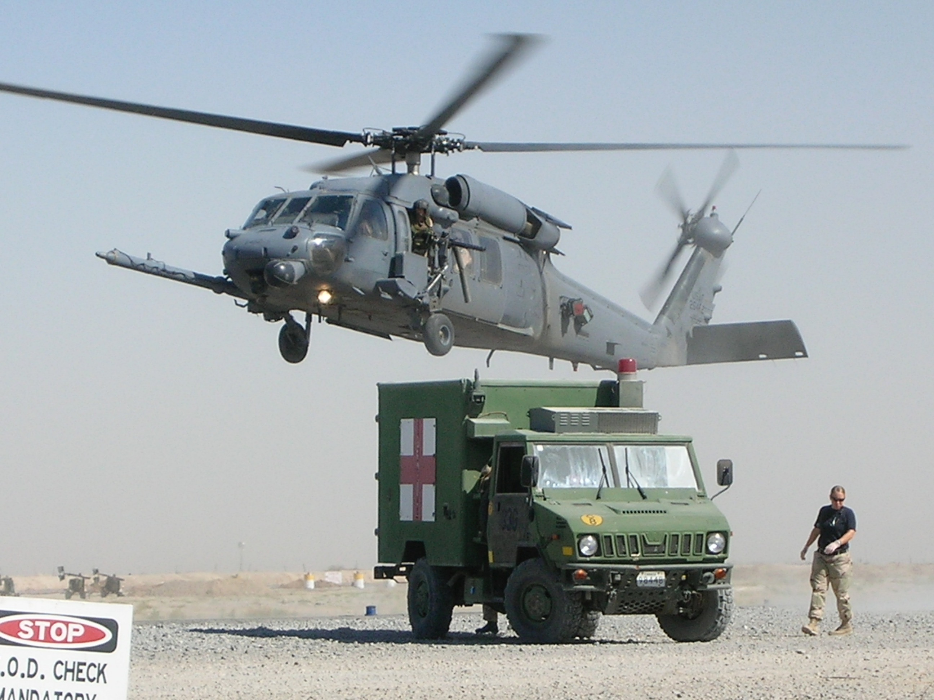
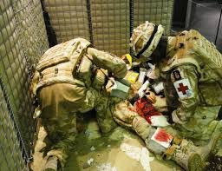
The Royal Army Medical Corps
In arduis fidelis

Slide 15
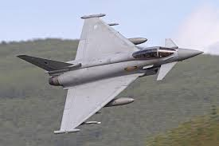
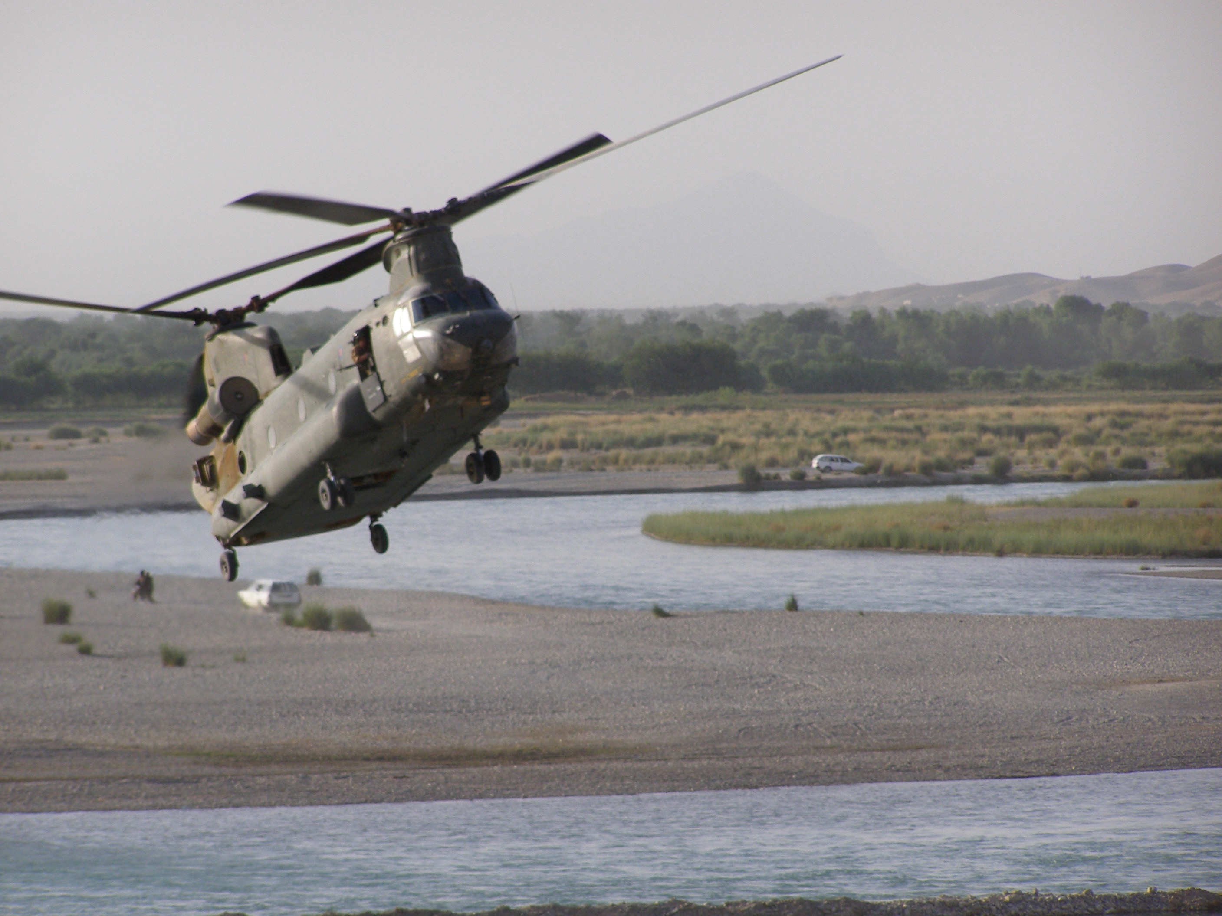
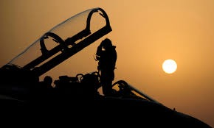
Royal Air Force
Per Ardua ad Astra

Slide 16
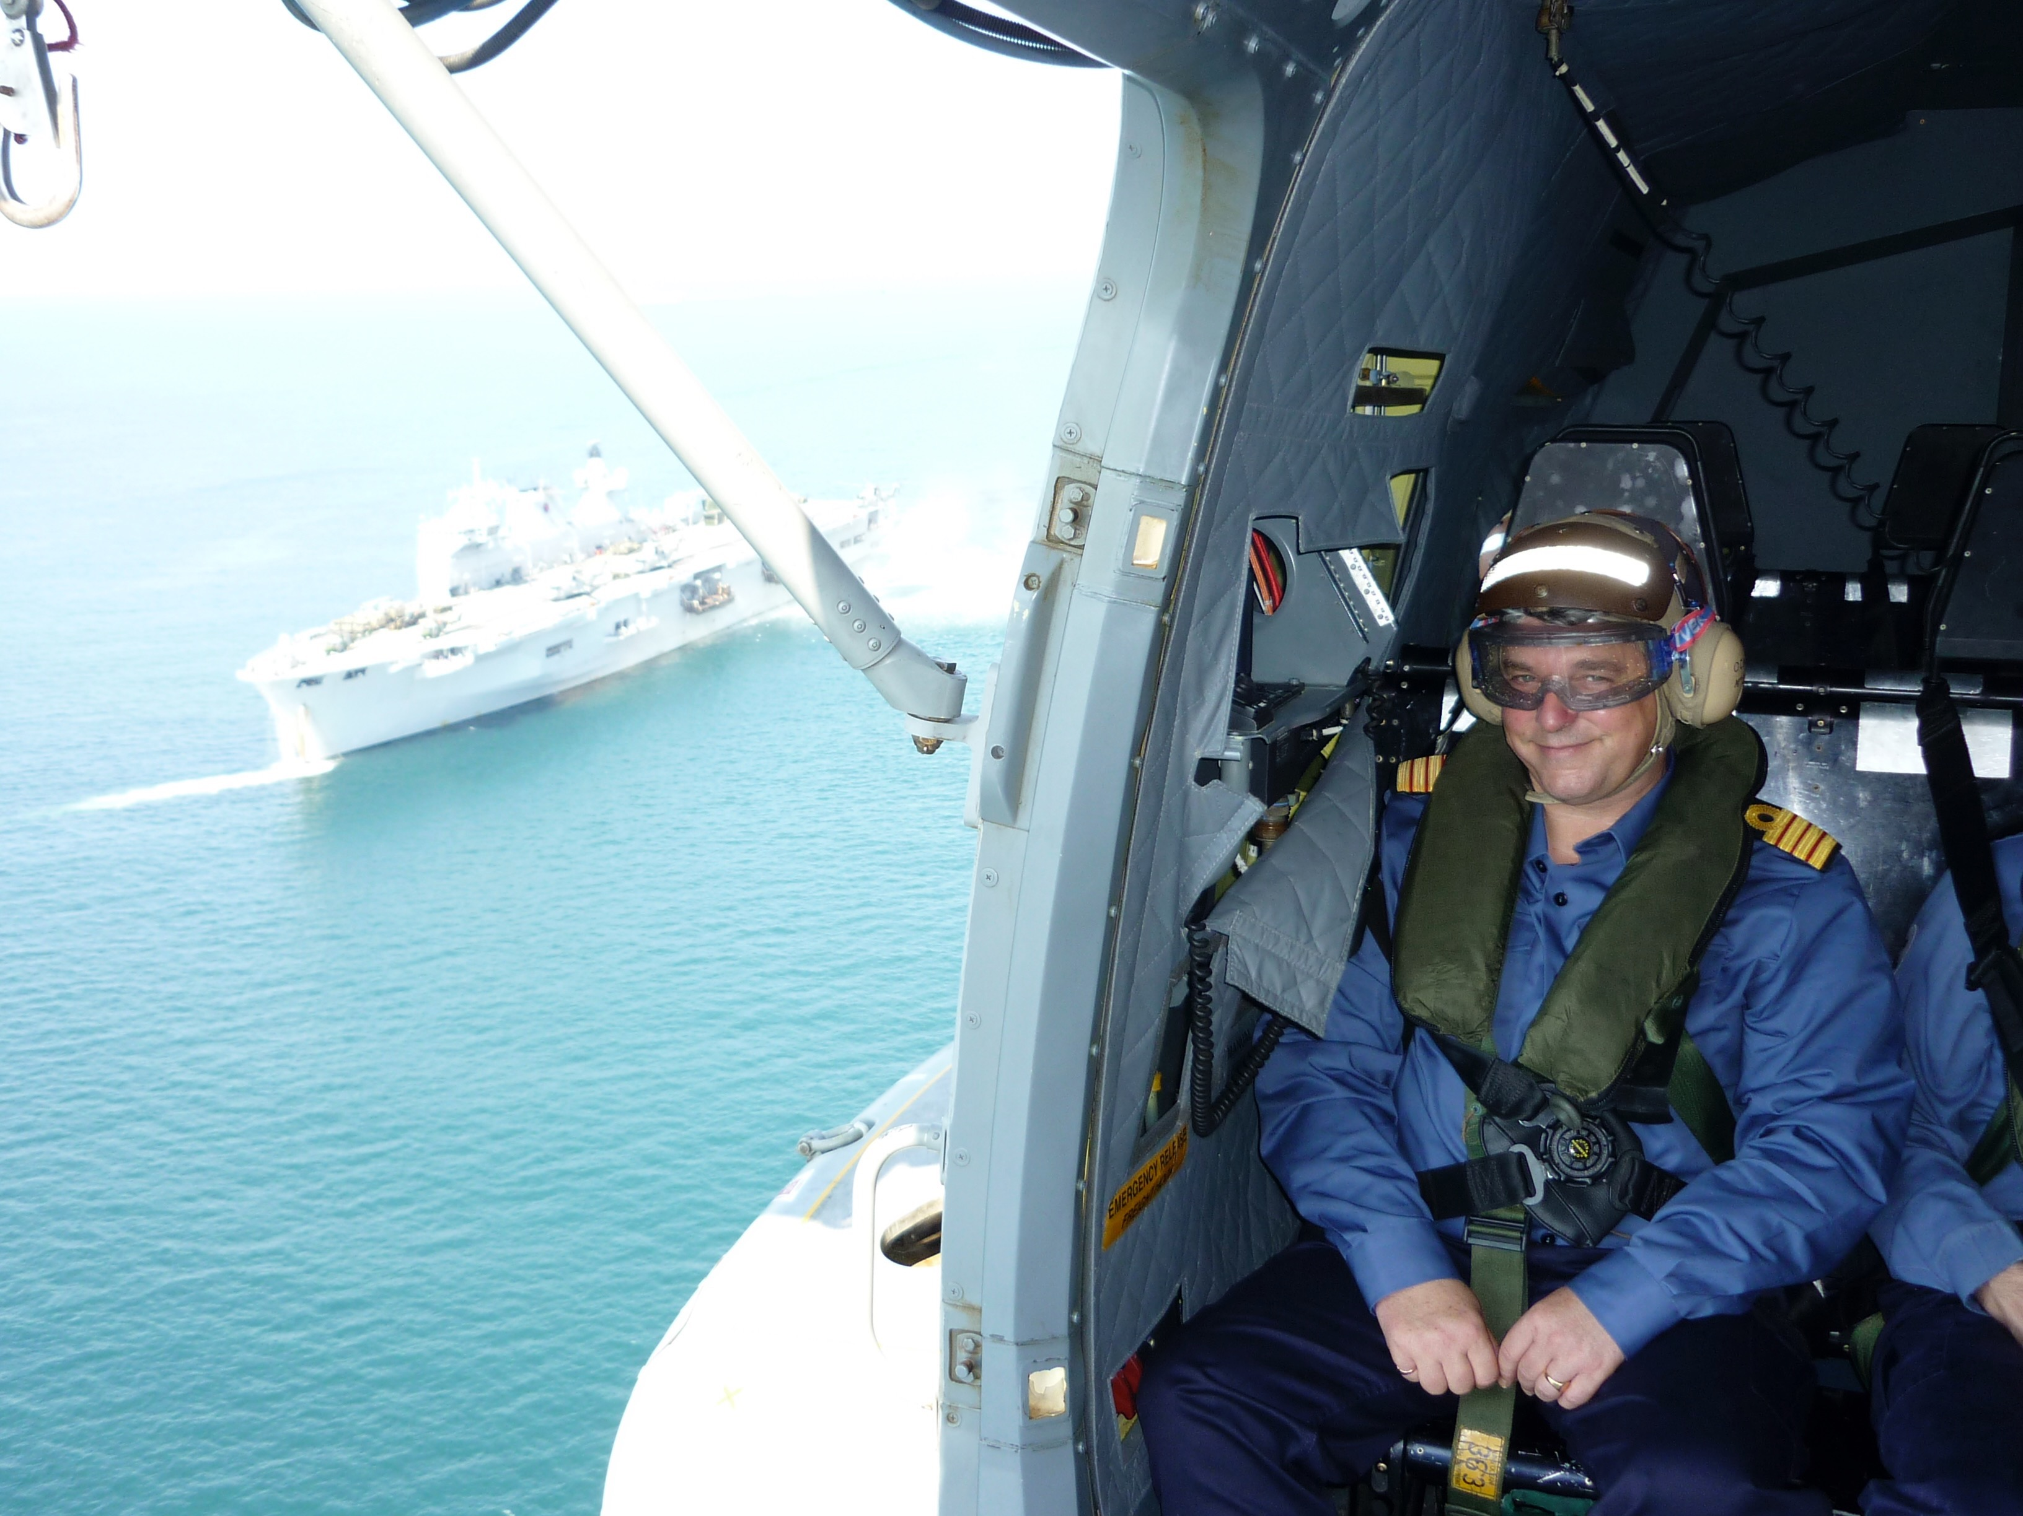

Slide 17
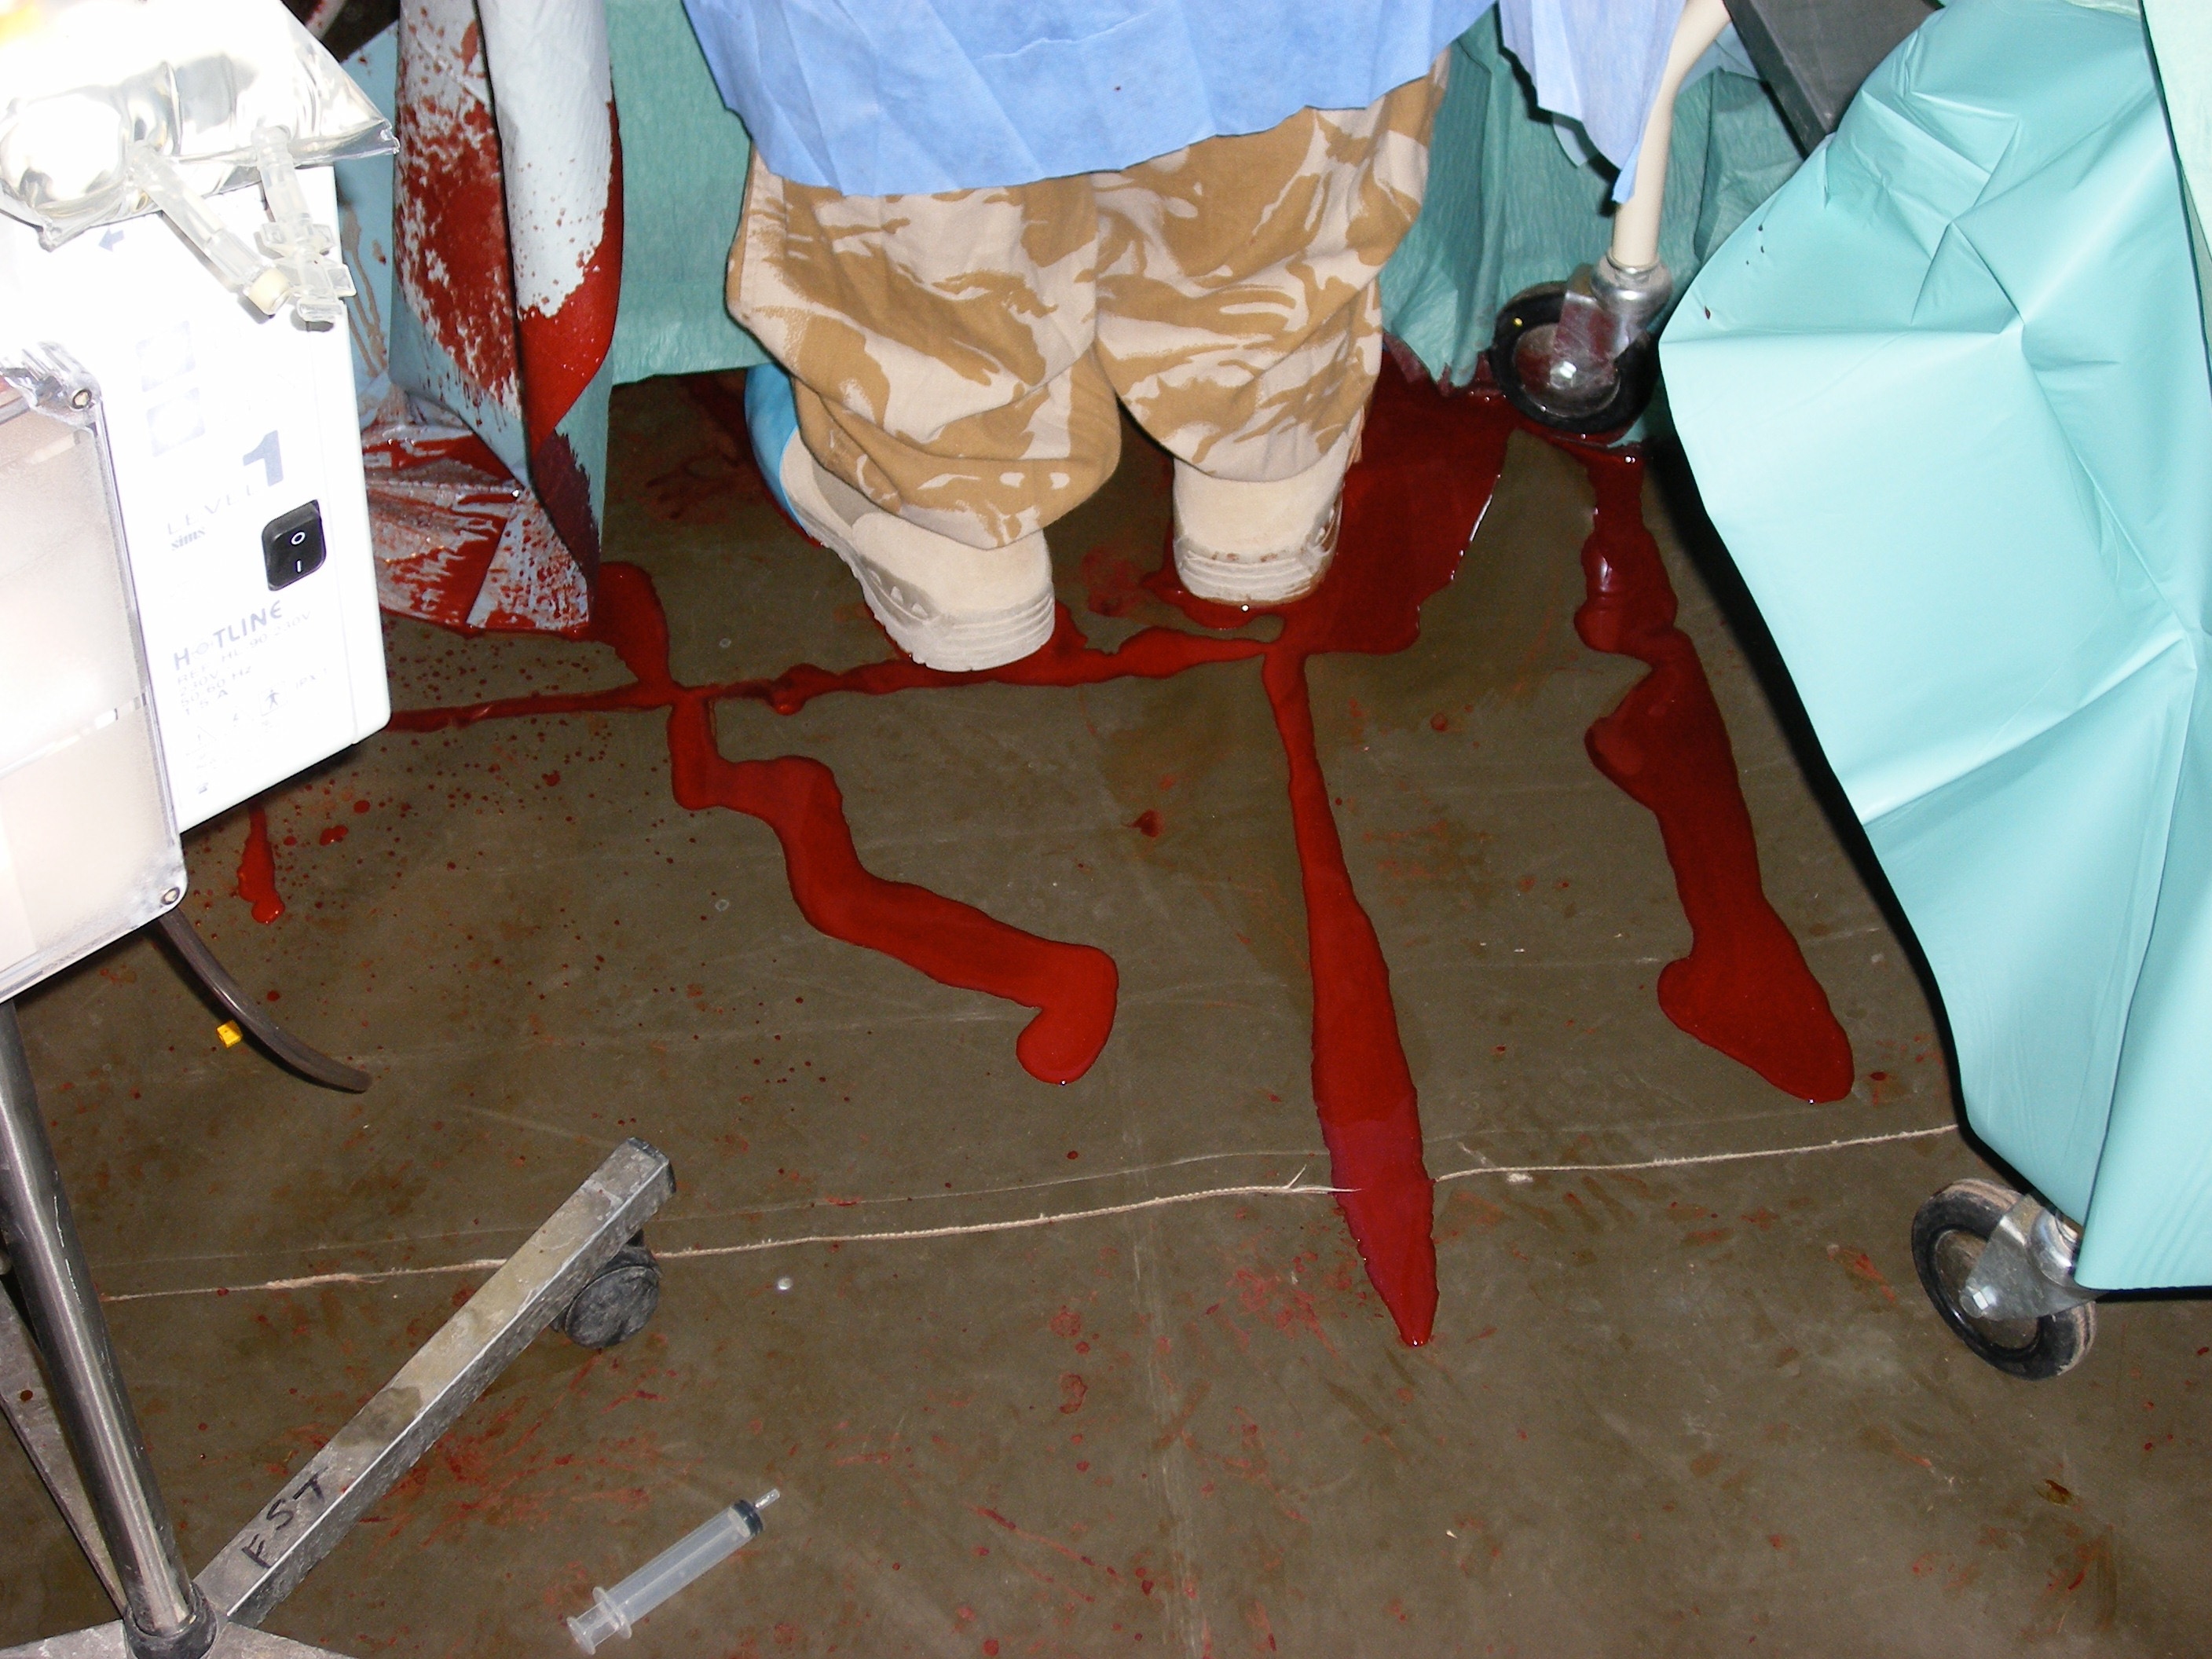

Slide 18
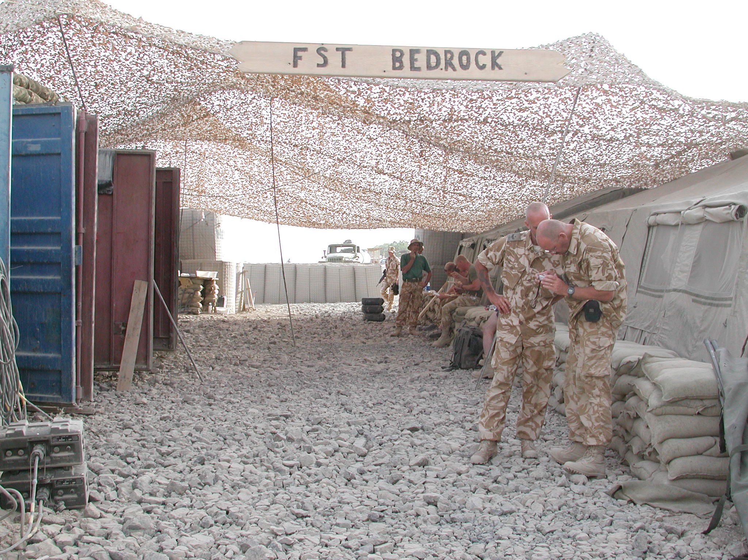

Slide 19
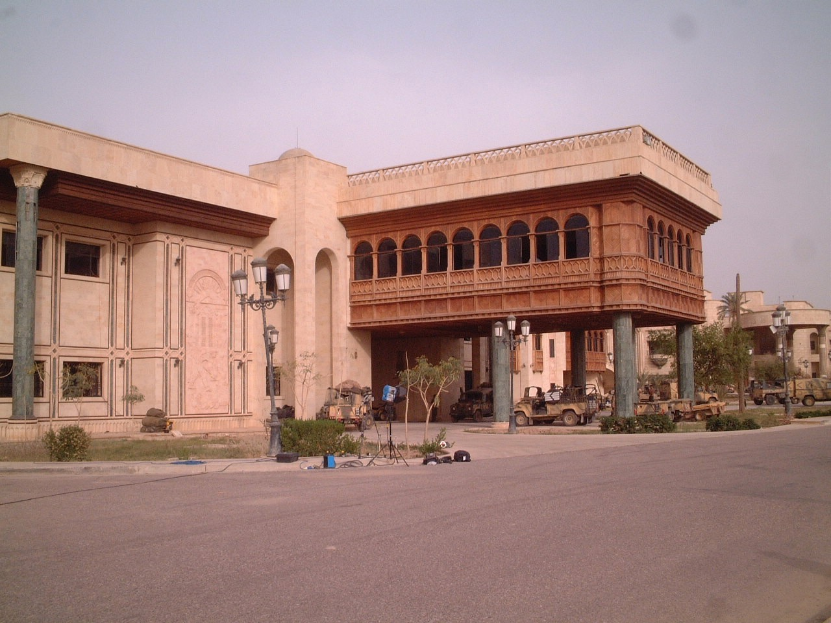

Slide 20
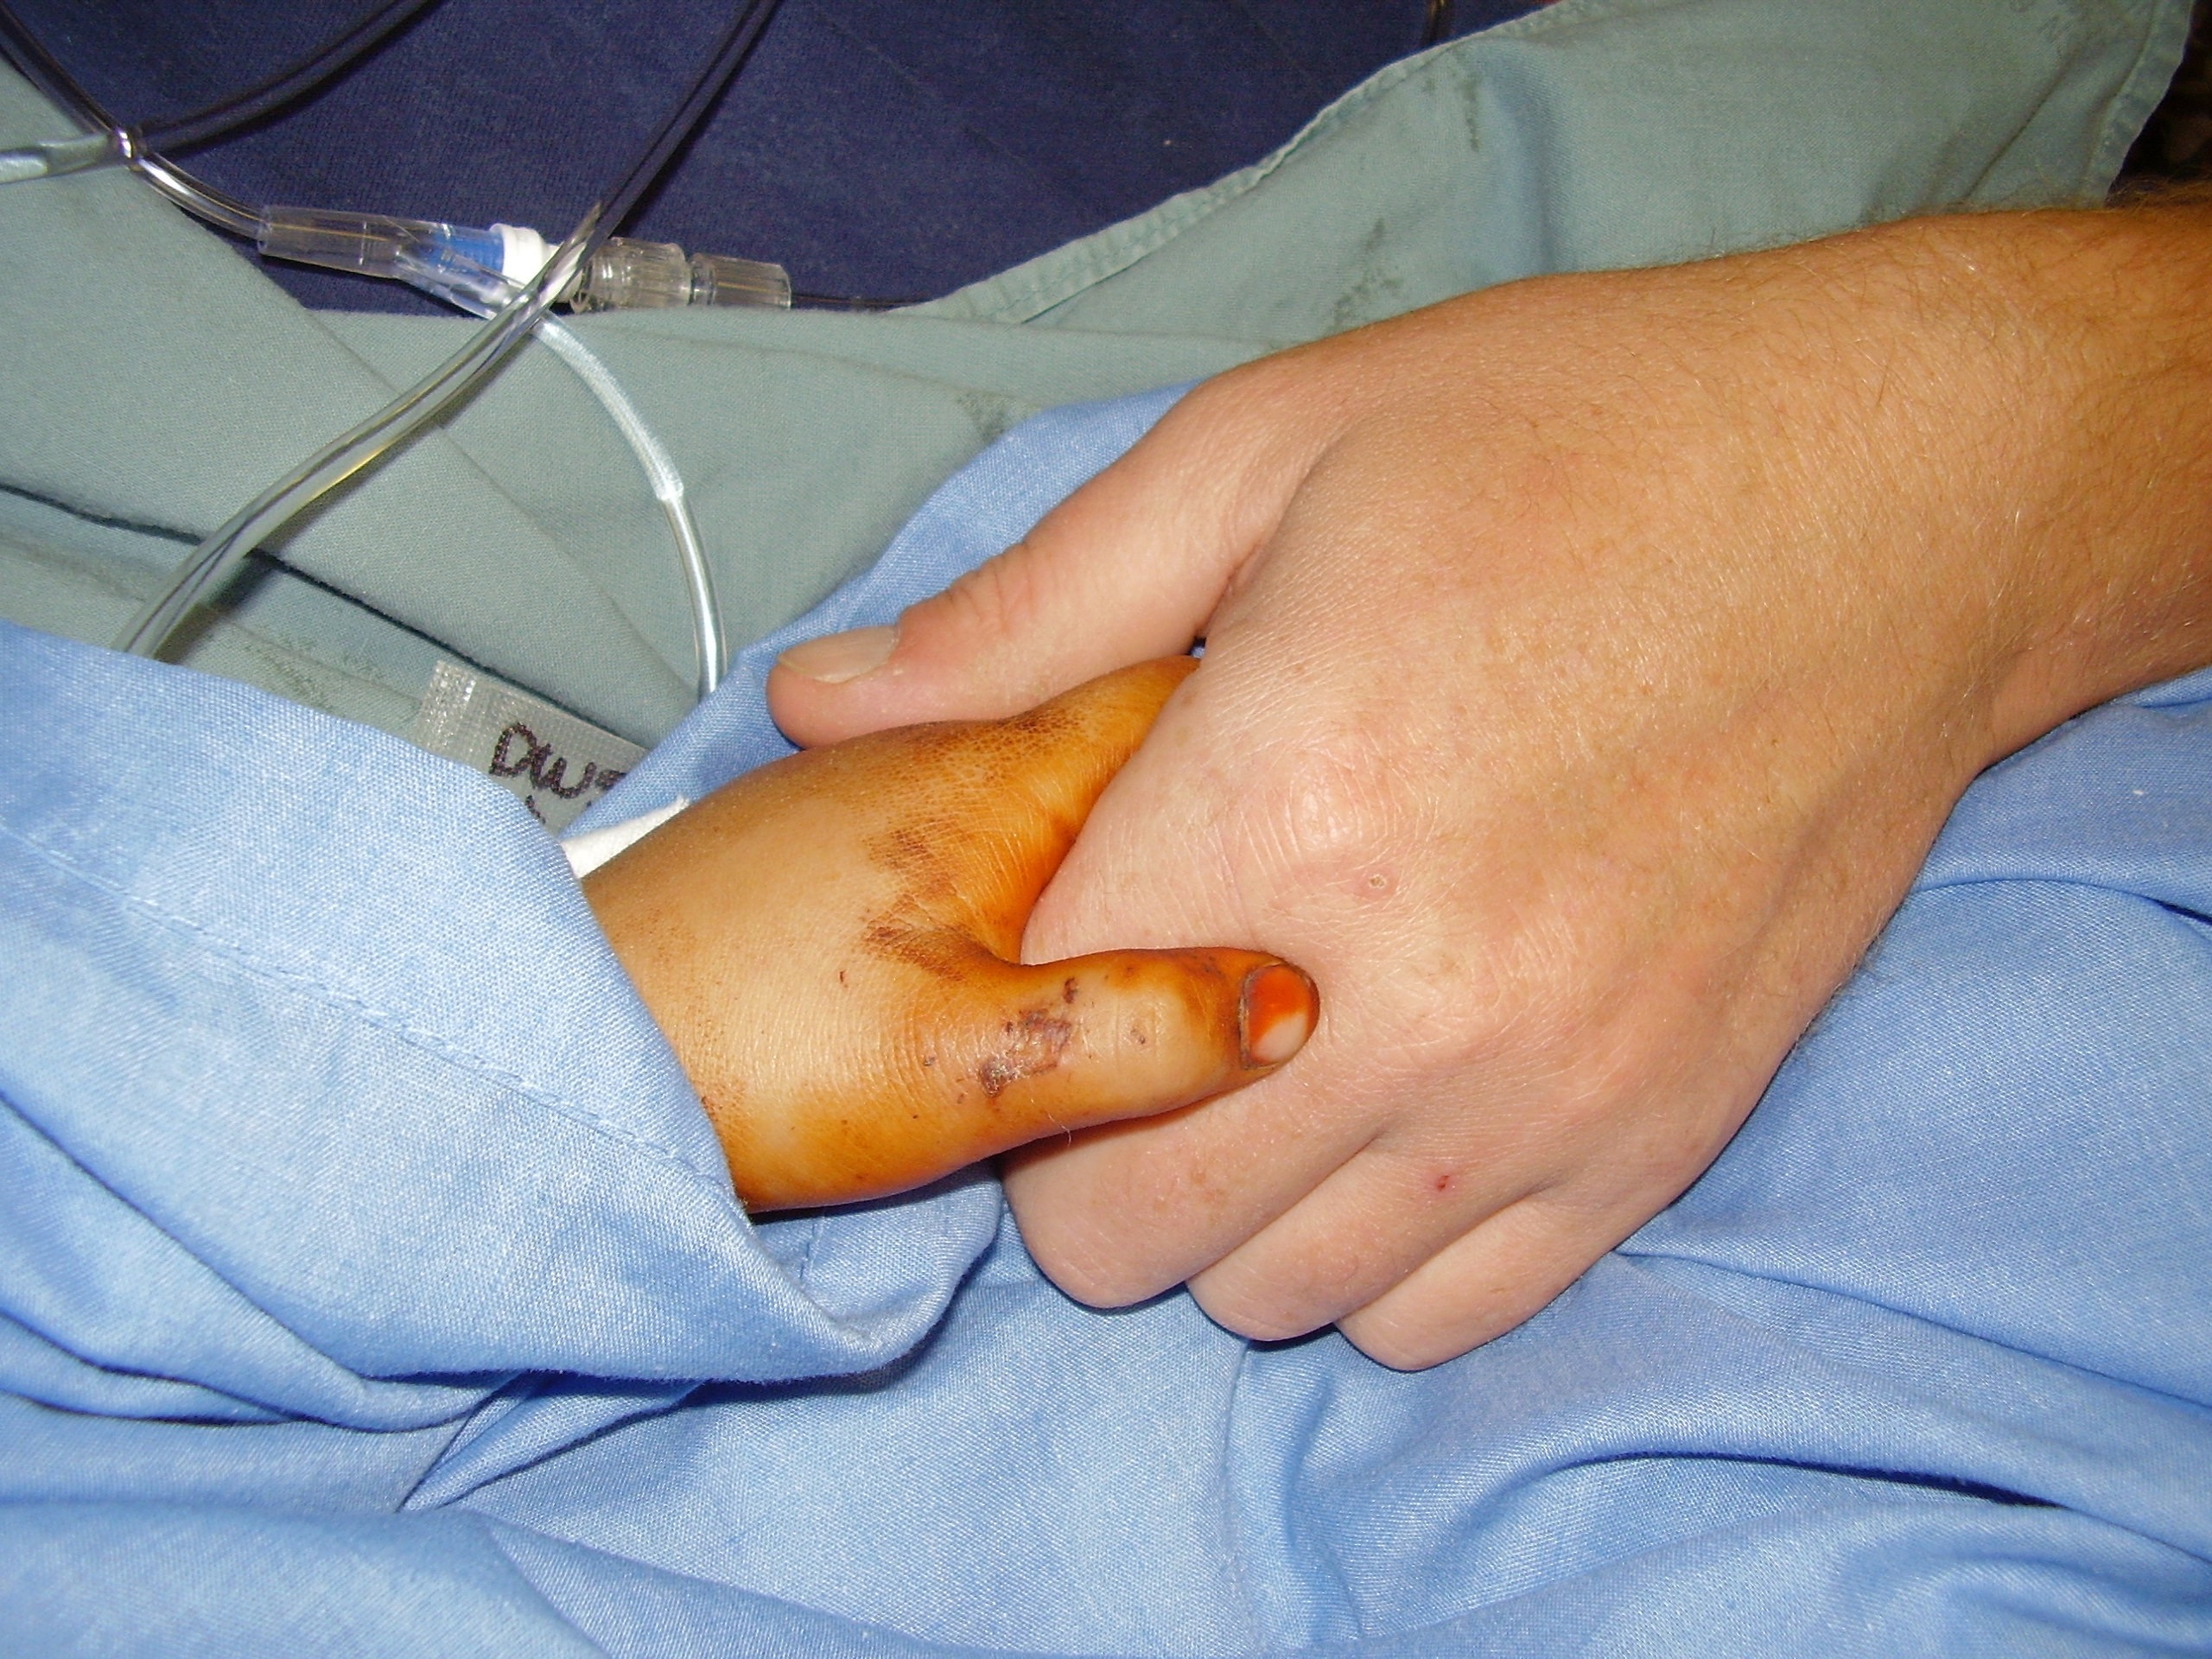
It’s a big wide world out there
Embrace everything at medical school
Be interested in things to be interesting yourself
Consider all the options and explore every avenue
Somewhere out there is a niche just for you

