Slide 1
Optimising Your Personal Statement
Mr Zahid Raza
Consultant Vascular Surgeon
MBChB Admissions, University of Edinburgh

Slide 2
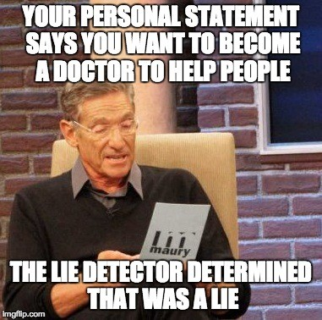

Slide 3
Why a personal statement?
Overview of the applicant
Sell yourself on paper
Will he/she make a good doctor?
Does he/she have adequate insight?
What non-academic qualities does the applicant have?
Will the applicant manage to complete their degree?

Slide 4
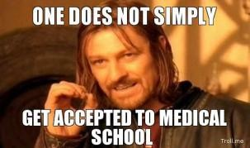
Writing your personal statement
Stay focused
Keep it simple
Only mention things you have done
Keep it relevant for Medical School application
Don’t break the rules
Mention your unique angle
Don’t overdo it and be truthful
Get others (medical students, doctors) to go over it

Slide 5
What does everyone have in their Personal Statement? (the boring bits)
Duke of Edinburgh award
Working in a care home
Working for a charity
Watched ER, Holby City (or worse have a box set)
Went abroad
Play a musical instrument/sport
Personal Bits:
Broke a bone
Had an operation
Have a sibling with a chronic disease
You have a chronic disease
Granny died
Saved someones life at Tesco

Slide 6
What do very few people have in their Personal Statement?
Evidence of communication skills
Appreciating the multidiciplinary team
Reflection
Commitment to lifelong learning and intense work
Humility and a sense of pride in the caring professions
Intellectual curiosity
Background reading (GMC, Ethics, Student BMJ)

Slide 7
What must I do to score in the Personal Statement?
The marking scheme is split
1. Personal Qualities
2. Insight & Career Exploration
3. Non Academic Activities
You need to score in all three domains
10% of applicants get full marks
Marks will vary from 0 to 12 (Edinburgh)
Each reviewer allocates up to 6 marks
Large discrepancy between reviewers – 3rd reviewer

Slide 8
Examples of Personal Statements

Slide 9
“… and several times a week I play football, basketball, rugby and squash. I am also a grade 8 in piano and grade 7 in singing. I enjoy travelling, photography and in my spare time, play the guitar and drums…”
Does this person actually have time to study Medicine?

Slide 10
“… as I arrived in A & E, the nurse gave me some painkillers and the doctor then took over and confirmed that I had broken my femur. I was impressed by her professionalism as she kept me calm whilst I was brought into the Orthopaedic ward. The doctor’s professionalism and caring attitude made me determined to follow the caring profession of medicine.”
What? You want to do medicine because a pretty female doctor kept you calm and diagnosed your broken bone … lets face it, you fancied her?

Slide 11
“I am fascinated by the science of genetics. The fact that simple deletions, translocations and inversions in the human chromosome can give rise to such variations in the phenotype has always intrigued me. I have spent my summer holidays in the Cavendish Laboratory isolating DNA from fruit flies in order to find a promoter of mutations…”
Maybe a genetics degree would be better?

Slide 12
“…during my week with a GP, I came across several interesting cases. This included a patient with a thigh sarcoma, an abdominal aortic aneurysm, phenylketonuria and Marfans syndrome. All these patients had different needs and I was impressed how primary care gave support and advice…”
Looks like these are the rare diseases your Daddy has seen in his whole career as a GP

Slide 13
Examples of ‘good’ personal statements

Slide 14
“Choosing to study medicine is not a decision I have taken lightly. It isn't a career I have wanted to do since a particularly young age, nor did a life changing event prompt my choice. I have thought very long and hard before deciding to apply”.
No arresting opening statement or a desire to be a doctor since birth. Honest and down to earth.

Slide 15
“…and during their journey to theatre, the emphasis on multi-disciplinary teamwork was evident and the versatility of all healthcare staff and their ability to make collaborative team decisions was clear. The surgeon, anaesthetist and nursing staff all worked in unison with patient safety as their prime concern…”
Reflects on a patient journey to an operating theatre; how the process involves a multi team approach

Slide 16
I have no doubts about my ambition to pursue a career in medicine. I genuinely believe that I have the academic ability and the mental drive to become one of ‘Tomorrow’s Doctors’, which, for me, would be a great privilege.
Finishing off the personal statement which highlights their drive and determination and a subtle message that the candidate is aware of the GMC guide.

Slide 17
Tips
Don’t make shopping lists of what you have done
Try to keep Churches, Mosques, Synagogues and Temples out of it
Do your first paragraph last
Make sure it ‘runs’ well
You’re trying to tell the university how amazing you are without boasting about it
If you get an interview – know EVERYTHING about what you have in your personal statement

Slide 18
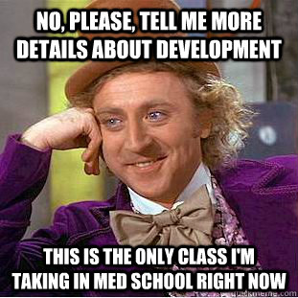
Awareness of other issues
There is a quota system present
State school versus private school
Widening participation scheme
‘Doctor bashing’
Parents profession
Parents education
Have you been in care?
Are you a carer?
Criminal record?

Slide 19
Finally…
It takes me 10 to 15 mins to ‘score’ a personal statement
I have a batch of 25 per week
I have to get through 200 – 300 over 2 to 3 months
Its quite laborious until an interesting candidate crops up
Make sure you stand out!

Slide 20
Good Luck

