Slide 1
How I Got Into Medical School
Kamran Raza
5th Year
University of Glasgow

Slide 2
Why I Wanted To Study Medicine
Interest in the human body
Working within a vast team
Opportunity to progress and specialise
Rewarding career choice
Job Security

Slide 3
First Attempt
16 years old
AAAAAAAB at Intermediate 2
AAAAB at higher
2480 UKCAT score (620 average)

Slide 4
Work Experience and Voluntary Service
One week at the Royal Infirmary of Edinburgh
Vascular surgery
Cardiology
Accident and Emergency
One week in general practice
Local nursing home
Headway House

Slide 5
Extra-Curricular Activities
Summer job at a dental surgery
Duke of Edinburgh’s Award
BSKC Karting Championships
Cricket
Squash

Slide 6
Application
Dundee
Edinburgh
Hull-York
Liverpool

Slide 7
Outcome
Dundee – REJECTION
Edinburgh – REJECTION
Hull-York – REJECTION
Liverpool - INTERVIEW

Slide 8
Liverpool Interview
Two interviewers
15 minutes, 10 questions
Basic questions
Work experience
Volunteering and achievements
Extra-curricular
Ethical case

Slide 9
Where (I Think) I Went Wrong
Too young and immature
Answers were too rehearsed
Monotonous and robotic
Lack of personality
Very nervous
Over-prepared
Poor selection of medical school

Slide 10
What I Did Next
Asked for feedback
Finished my advanced highers
Volunteered in Ghana
Volunteer at medical courses
Fundraising for charity
Work experience in medical research
Got a job as a healthcare assistant
Contacted universities about marking process

Slide 11
Second Attempt
BBC at advanced higher
2700 UKCAT score (Average 675)
Better awareness are preparation

Slide 12
Application (Round Two)
Aberdeen
Dundee
St Andrews
Glasgow
Dundee (Dentistry)

Slide 13
Outcome
Aberdeen - REJECTION
Dundee - REJECTION
St Andrews - REJECTION
Glasgow - INTERVIEW
Dundee (Dentistry) - INTERVIEW

Slide 14
The Glasgow Interview
Two interviewers and one scribe
Very friendly
15 minutes, 15 questions
Basic questions
Work experience
Volunteering and achievements
Extra-curricular
Ethical case (pre-read)
Current medical issues

Slide 15
The Dundee Interview
Multiple Mini Interview (MMI)
12 stations
Personal statement station
Interview stations
Problem solving stations
Communication stations
Ethical scenario stations
Surprisingly fun!

Slide 16
Statistics
The UKCAT average scores
2010 - 2489
2011 – 2475
2012 - 2515
2013 – 2643
2014 – 2505
2015 – 2531
2016 – 1893** (2366)
82,034 UCAS applications for 7424 places in 2015 (11 applications per place!)
Aberdeen – 1 in 5.9 receive offers (2015)
Dundee – 1 in 6.5 receive offers (2015)
Edinburgh – 1 in 7.3 receive offers (2015)
Glasgow – 1 in 4.6 receive offers (2016)
St Andrews – 1 in 4 received offers (2014)
Notes:
.6

Slide 17
Useful Tips
Join the Student Room
Personal Statement
Variation of work experience
Contact Universities
Apply wisely
Know about current medical issues
Don’t over-prepare for interviews

Slide 18
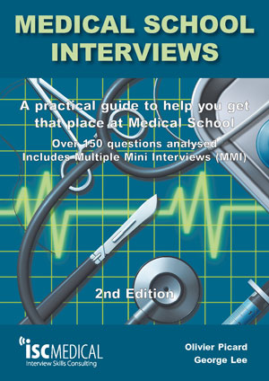
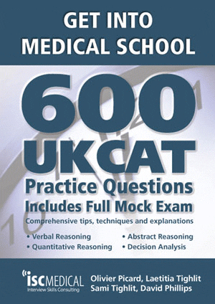
Useful Resources

Slide 19
Useful Resources

Slide 20
Any Questions?

