Slide 1
Getting into Medical School – the facts
Dr Karen Foster, Admissions Lead (Medicine)
24th June 2017

Slide 2
Why do I want to be a doctor?

Slide 3
Why do I want to be a doctor?
Good reasons:
Good at and interested in science.
Want to work with people.
Interested in helping people.
Want a challenging, stimulating job.
Want a job with responsibility.
Want a job where I never stop learning.

Slide 4
Why do I want to be a doctor?
Bad reasons:
I got 5 As at Higher so it would be a waste not to apply for Medicine.
My mum and dad want me to be a doctor.
I want to be well paid and respected.
My school/teachers would like me to apply for Medicine.
I like Grey’s Anatomy.

Slide 5
Where should I apply to?

Slide 6
Where should I apply to?
Not every medical school is the same.
Every medical school has a detailed website.
You need to do your homework.
Curriculum: traditional; problem-based learning; pre-clinical/clinical split; intercalated degree.
Clinical attachments: urban, rural.

Slide 7
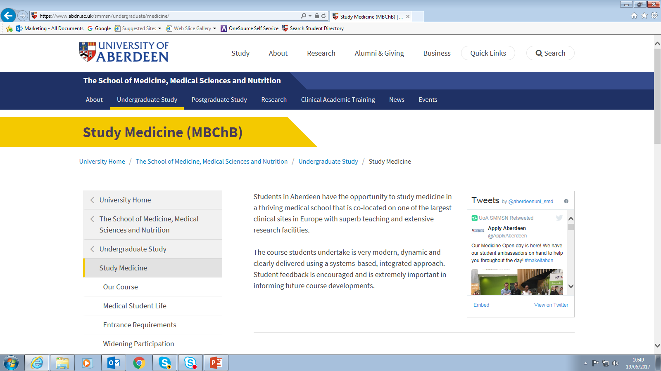
Medicine at Aberdeen

Slide 8
Where should I apply to?
Resources: clinical skills, anatomy, hospitals, student support, accommodation.
Research interests and expertise.
Student societies and activities.
Location; mountains, shops, sea, proximity to home.

Slide 9
Where should I apply to?
Every medical school has a detailed website.
Medical Schools Council has links to all UK medical schools.
http://www.medschools.ac.uk/Students/UKMedicalSchools/Pages/default.aspx
General Medical Council (GMC) regulator for all UK medical degrees.

Slide 10
Where should I apply to?
Access to Medicine and Pre-med courses are available.
You may be eligible for one of these.

Slide 11
What is the admission process?

Slide 12
What is the admission process?
Not every medical school is the same.
Every medical school has a detailed website.
You need to do your homework.
Academic requirements
Non-academic requirements
UKCAT (or other test)
Interview

Slide 13
Academic requirements
National 5
Highers
Advanced Highers
Subjects required
S6 conditions
Extenuating circumstances

Slide 14
Non-academic qualifications
Commitment to Medicine; Core Qualities; Team working; Your interests/hobbies.
Advise on the Medical School’s website.
Medical Schools Council ‘Statement on the core values and attributes needed to study medicine’
http://www.medschools.ac.uk/SiteCollectionDocuments/Statement-on-core-values-and-attributes.pdf
Medical Schools Council ‘Work experience guidelines for applicants to medicine’
http://www.medschools.ac.uk/SiteCollectionDocuments/Work-experience-guidelines-for-applicants-to-medicine.pdf

Slide 15
UKCAT
Undertake UKCAT each year you apply.
Register for test 3rd May – 19th Sept 2017: undertake test 3rd July – 3rd October 2017.
Book test early to ensure a place.
Fee reimbursed if test cancelled later.
SEN version available.
Bursary available.
PRACTISE, PRACTISE, PRACTISE!

Slide 16
Interviews
Different formats: MMI, traditional.
Preparation is essential: books, websites, previous applicants.
Practise and think of examples; talk out loud – friends, teachers, parents
Don’t learn your answers off by heart!

Slide 17
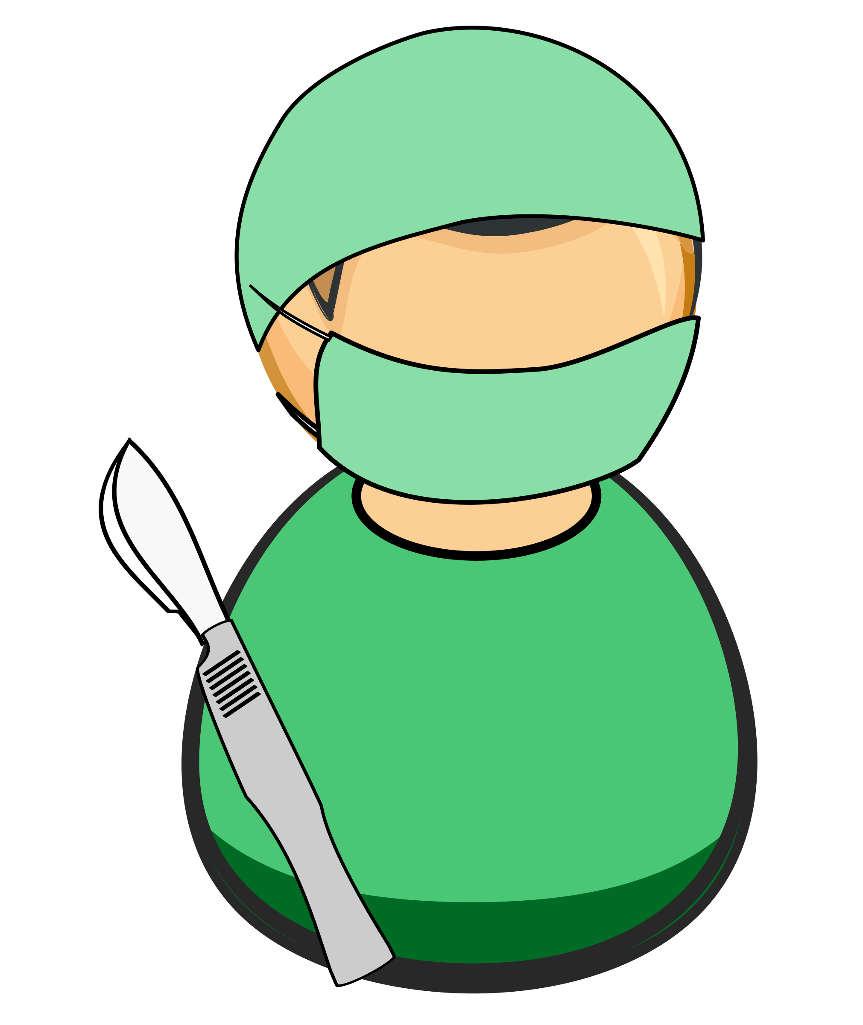
Fitness to practice
Disabilities
Illnesses
Convictions
Immunisations
Protection of Vulnerable Groups
Professionalism – expectations of medical students and doctors.
Application process and making an Offer.

Slide 18
Deferred entry/Gap Year
Check with individual Universities re policy.
Plan some relevant experience during the year.
Deferral of an offer cannot always be granted.

Slide 19
What other resources are available?

Slide 20
Resources
Medical Schools Council
Applying to Medical School http://www.medschools.ac.uk/STUDENTS/HOWTOAPPLY/Pages/default.aspx
NHS Health Careers
https://www.healthcareers.nhs.uk/
Scottish Medical Training
http://www.scotmt.scot.nhs.uk/careers.aspx

Slide 21
Resources
General Medical Council
Good Medical Practice
http://www.gmc-uk.org/static/documents/content/GMP_.pdf
Medical students professionalism and fitness to practice
http://www.gmc-uk.org/education/undergraduate/studentftp.asp
Outcomes for Graduates
http://www.gmc-uk.org/static/documents/content/Outcomes_for_graduates_Dec_16.pdf

Slide 22
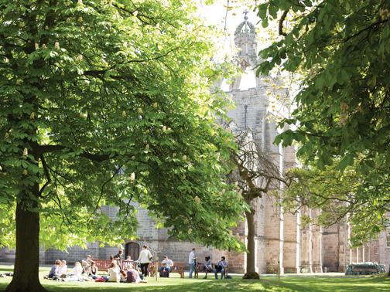
Resources
University Open Days and visits
Medical School events
Reach programme

Slide 23
Questions?

